Slide 1


Grow with Ginkgo
J.P. Morgan Healthcare Conference
Jason Kelly
Co-Founder & CEO
January 16, 2024 10:30AM Pacific

Slide 2
Disclaimer
Forward-Looking Statements
This presentation, the conference call and webcast (together, the “presentation”) contain certain forward-looking statements within the meaning of the federal securities laws, including statements regarding our plans, strategies, including with respect to our balance sheet and cash runway, current expectations, operations and anticipated results of operations, both business and financial, including the timing for attaining adjusted EBITDA breakeven and profitability, the success of our new offerings and anticipated impacts on our results, our planned reduction in workforce and anticipated impacts thereof, the timing and structuring of our planned site consolidation and the potential financial impact thereof, opportunities for and timing of increased operational efficiency and the expected impact on our operational expenditures, potential customer success, including successful application of our offerings by our customers, the capabilities and potential operational and financial success of our partnerships and collaborations, and expected timing thereof, expectations with regard to revenue, the nature of such revenue and any related downstream value share associated with such revenue, funding that is contingent upon Ginkgo’s achievement of milestones, expenses, including our stock-based compensation expenses, our full year 2024 outlook, the expansion, timing and potential capabilities of our biosecurity monitoring, surveillance and detection systems, and the market environment, all of which are subject to known and unknown risks, uncertainties and other factors that may cause our actual results, performance or achievements, market trends, or industry results to differ materially from those expressed or implied by such forward-looking statements. These forward-looking statements generally are identified by the words "believe," "can," "project," "potential," "expect," "anticipate," "estimate," "intend," "strategy," "future," "opportunity," "plan," "may," "should," "will," "would," "will be," "will continue," "will likely result," and similar expressions. Forward-looking statements are predictions, projections and other statements about future events that are based on current expectations and assumptions and, as a result, are subject to risks and uncertainties. Many factors could cause actual future events to differ materially from the forward-looking statements in this presentation, including but not limited to: (i) our ability to realize near-term and long-term cost savings associated with our site consolidation plans, including the ability to terminate leases or find sub-lease tenants for unused facilities, (ii) volatility in the price of Ginkgo's securities due to a variety of factors, including changes in the competitive and highly regulated industries in which Ginkgo operates and plans to operate, variations in performance across competitors, and changes in laws and regulations affecting Ginkgo's business, (iii) the ability to implement business plans, forecasts, and other expectations, and to identify and realize additional business opportunities, (iv) the risk of downturns in demand for products using synthetic biology, (v) the uncertainty regarding the demand for passive monitoring programs and biosecurity services, (vi) changes to the biosecurity industry, including due to advancements in technology, emerging competition and evolution in industry demands, standards and regulations, (vii) the outcome of any pending or potential legal proceedings against Ginkgo, (viii) our ability to realize the expected benefits from and the success of our Foundry platform programs, (ix) our ability to successfully develop engineered cells, bioprocesses, data packages or other deliverables, (x) the product development or commercialization success of our customers, and (xi) the potential negative impact on our business of our planned reduction in force or the failure to realize the anticipated savings associated therewith. The foregoing list of factors is not exhaustive. You should carefully consider the foregoing factors and the other risks and uncertainties described in the "Risk Factors" section of Ginkgo's annual report on Form 10-K filed with the U.S. Securities and Exchange Commission (the "SEC") on February 29, 2024 and other documents filed by Ginkgo from time to time with the SEC. These filings identify and address other important risks and uncertainties that could cause actual events and results to differ materially from those contained in the forward-looking statements. Forward-looking statements speak only as of the date they are made. Readers are cautioned not to put undue reliance on forward-looking statements, and Ginkgo assumes no obligation and does not intend to update or revise these forward-looking statements, whether as a result of new information, future events, or otherwise. Ginkgo does not give any assurance that it will achieve its expectations.
Industry and Market Data
In this presentation, Ginkgo relies on and refers to certain information and statistics regarding the markets and industries in which Ginkgo competes. Such information and statistics are based on Ginkgo management’s estimates and/or obtained from third-party sources, including reports by market research firms and company filings. While Ginkgo believes such third-party information is reliable, there can be no assurance as to the accuracy or completeness of the indicated information, and Ginkgo has not independently verified the accuracy or completeness of the information provided by the third-party sources.
Trademarks
This presentation may contain trademarks, service marks, trade names and copyrights of other companies, which are the property of their respective owners, and Ginkgo’s use thereof does not imply an affiliation with, or endorsement by, the owners of such trademarks, service marks, trade names and copyrights. Solely for convenience, some of the trademarks, service marks, trade names and copyrights referred to in this presentation may be listed without the TM, © or ® symbols, but Ginkgo will assert, to the fullest extent under applicable law, the rights of the applicable owners, if any, to these trademarks, service marks, trade names and copyrights.

Slide 3
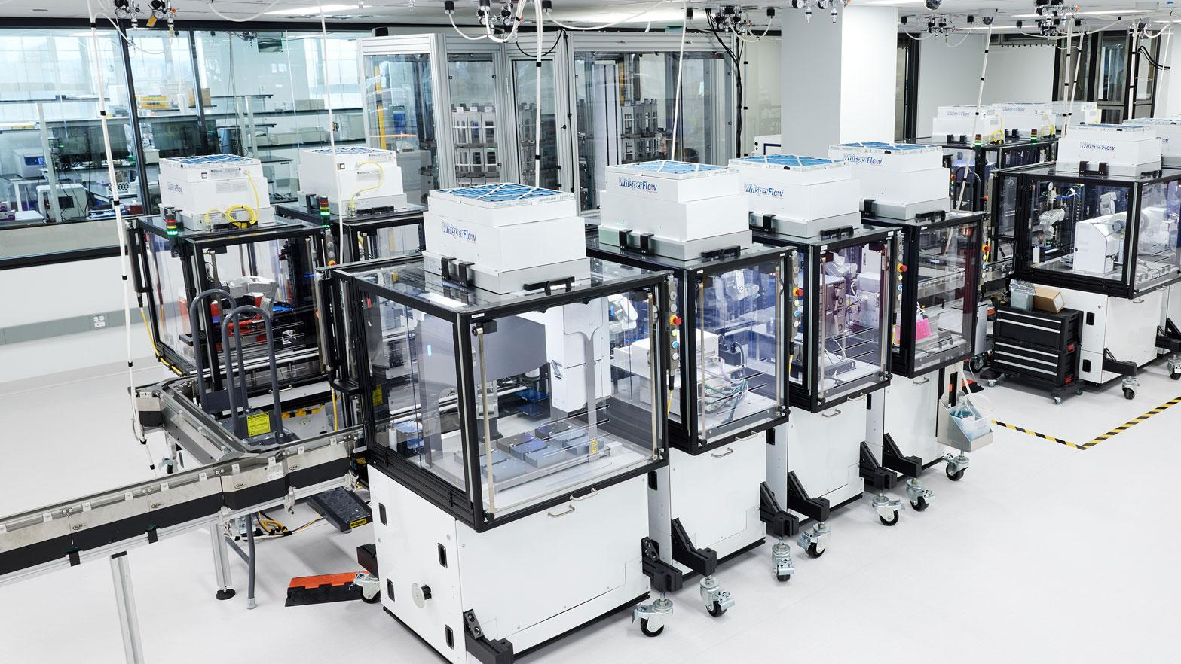
OUR MISSION
Make biology easier to engineer

Slide 4
We believe…
1
2
3
Ginkgo continues to grow our revenue in biopharma
Restructuring in mid-2024 has greatly reduced cash opex
Expansion into direct sales of life science tools & services is opening new markets for our transformational tech

Slide 5
We believe…
1
2
3
Ginkgo continues to grow our revenue in biopharma
Restructuring in mid-2024 has greatly reduced cash opex
Expansion into direct sales of life science tools & services is opening new markets for our transformational tech

Slide 6
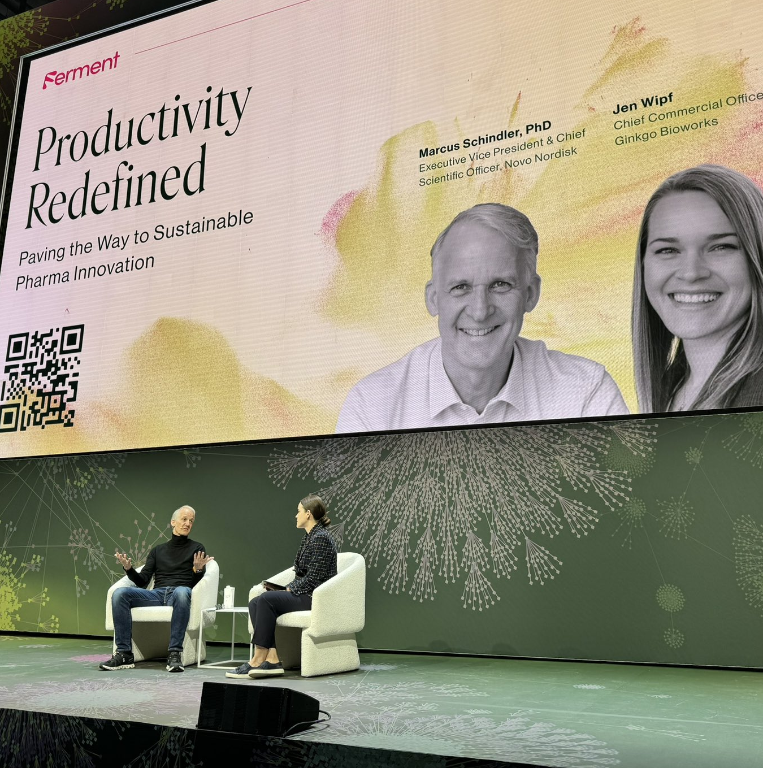


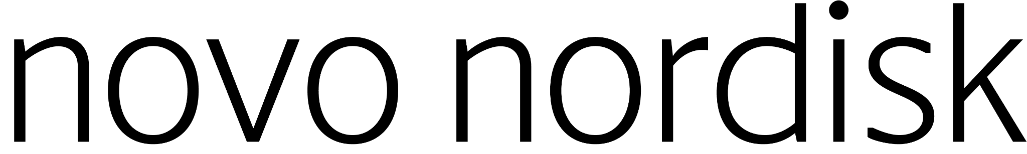
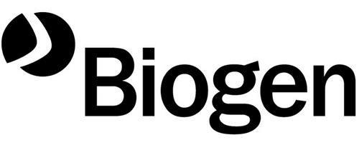





Ginkgo continued to grow our biopharma business in 2024
More than 40 ongoing
biopharma partnered programs:
More than 90 ongoing industrial biotech, food & ag, consumer, and government partnered programs:

Slide 7


Ginkgo continues to deliver for its customers as it reaches a major research milestone with Merck
Ginkgo Bioworks Advances Collaboration with Merck to Improve Biologics Manufacturing
We're excited to achieve the first milestone of our collaboration with Merck and continue our work to improve biologic manufacturing production. It’s very meaningful when our team can drive impactful and technically innovative work like this, especially when we’re working shoulder-to-shoulder with counterparts like the team at Merck. As we go into the next phase of this project, we’ll continue to deploy the strain engineering, high-throughput screening and process development capabilities, as well as the assets and know-how that make Ginkgo a unique and powerful partner to top pharmaceutical companies.
Completion of the first milestone of the previously announced partnership with Merck
1
As part of this milestone completion, Ginkgo received a research milestone payment of $9 million in cash in Q4 2024
2
With Stage 1 complete, Merck and Ginkgo will move to Stage 2 focused on continuing to improve the production process
3
JASON KELLY CEO, co-founder
November 12, 2024

Slide 8
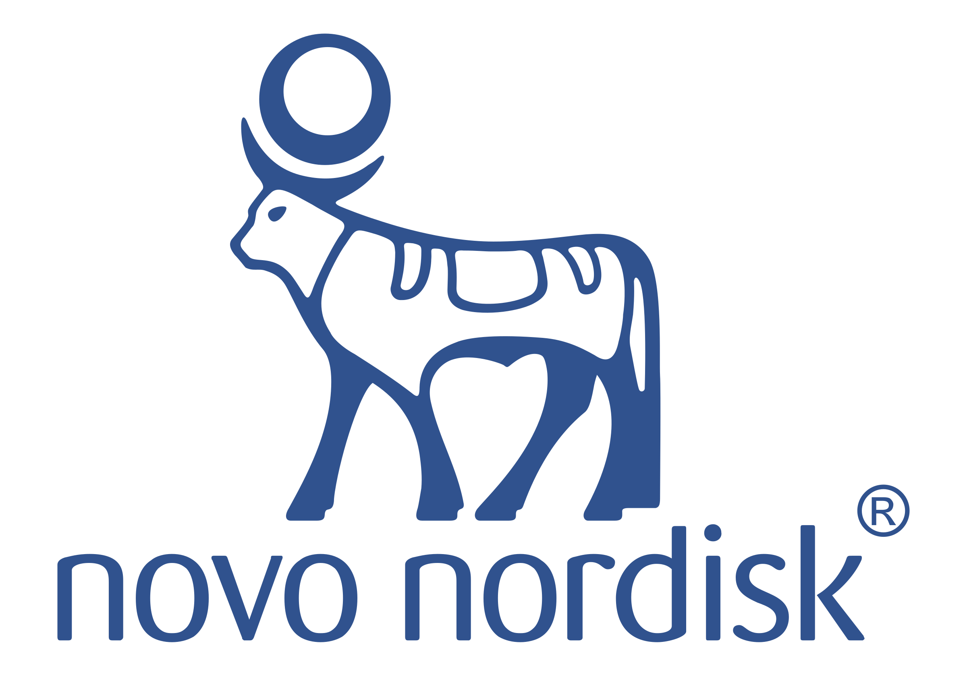
Novo Nordisk represents a model for what we can accomplish with key customers as we demonstrate our capabilities
Ginkgo Bioworks and Novo Nordisk to Collaborate on Expression Systems for Pharmaceutical Products
Ginkgo Bioworks and Novo Nordisk Expand Alliance to Collaborate Across R&D Value Chain
Expansion of the collaboration on expression systems for pharmaceutical products first announced in June 2022
LEARN MORE
LEARN MORE
Jun. 2022
Jul. 2023
Apr. 2024
Sep. 2024
Oct. 2024
Ginkgo Bioworks Advances Collaboration with Novo Nordisk on Expression Systems for Pharmaceutical Products
Expansion of April 2024 partnership, focused on the discovery and development of proteins
LEARN MORE

Slide 9

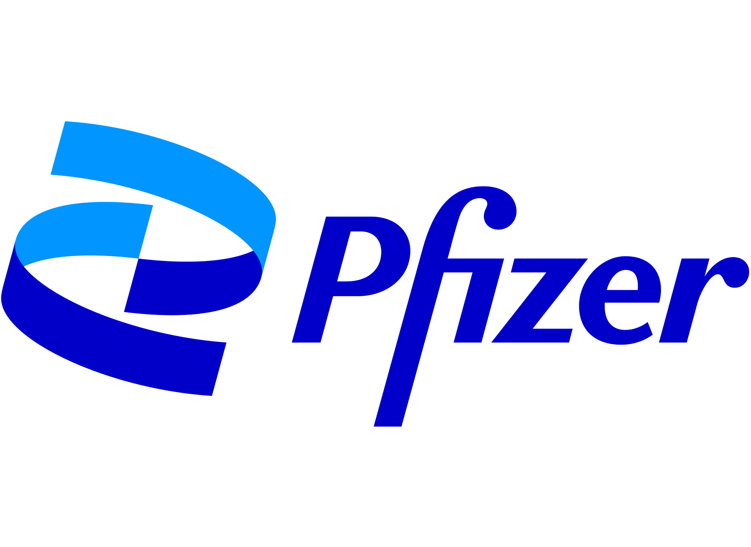
Ginkgo continued to deliver value and scientific breakthroughs
across our pharma partnerships in 2024
"Ginkgo's achievement of the first milestone has both excited and inspired us, giving us the confidence to move into the next phase of this ambitious project. This progress is a strong indicator of the potential we have to engineer biological systems that will expand the chemical space of biological medicines."
"At Merck we are always seeking new and innovative ways to optimize process efficiency while maintaining product integrity," said Dr. Michael Kress, Senior Vice President, Development Sciences and Clinical Supply, Merck Research Laboratories. "We are pleased to build upon our relationship with the Ginkgo Bioworks team."
"We believe that Ginkgo’s unique combination of cell programming expertise, proprietary tools, and knowledge of biological systems make them an ideal collaboration partner to explore a large number of design ideas with the goal of optimizing constructs."
ALPHONSE GALDES
Fmr. Head of Pharmaceutical Operations & Technology
LEARN MORE
"Access to Ginkgo's proprietary platform will help enable Pfizer to search for novel and exciting RNA constructs with improved stability and expression that could lead to more effective treatments."
BRIAN VANDAHL SVP, Global Research Technologies
MICHAEL KRESS
SVP, Developmental Sciences & Clinical Supply
WILL SOMERS
Head of Biomedicine Design
LEARN MORE
LEARN MORE
LEARN MORE

Slide 10
We believe…
1
2
3
Ginkgo continues to grow our revenue in biopharma
Restructuring in mid-2024 has greatly reduced cash opex
Expansion into direct sales of life science tools & services is opening new markets for our transformational tech

Slide 11
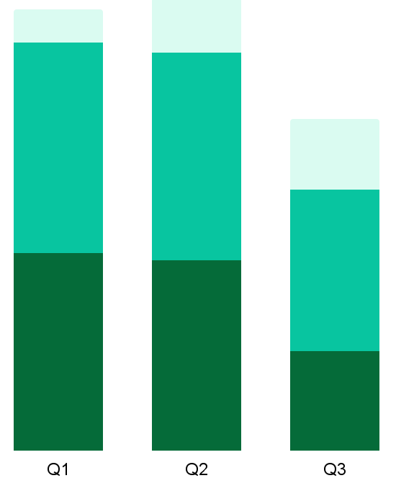
Restructuring accomplishments to date
Annualized, Run-Rate Cash Opex
~$500M ⁽¹⁾
~$515M ⁽¹⁾
Space
People
Transitioning out of several offices to reduce overall footprint
Boston area site consolidation complete by end of year, approximately 6 months ahead of schedule
Space
~$375M ⁽¹⁾
People
Previously announced headcount reduction of ~35%
Other expenses (overhead & program execution spending)
Contractor and temp labor pool reduced by nearly 60%
Professional fees reduced by ~40% Q3 vs Q1
Significant reduction in software licenses and applications through strict rationalization
Other Expenses
Q1, Q2, and Q3 2024 R&D and G&A Expenses (excluding one-time M&A costs, stock-based compensation, depreciation & amortization, and non-cash lease expenses), respectively, multiplied by 4

Slide 12
Ginkgo is six months ahead of schedule in Site Consolidation
Boston / Cambridge
✘1 ABP (Parcel O/P)
21-25 Drydock
23 Drydock
27 Drydock
451D
✘10 WIlson
✘45 Moulton
Cambridge Exit: 11/30/24
Evry Sold Altar SAS to Lesaffre including ALE entity in France. Transaction closed 9/30/2024.
Zeist Site closure activities are underway. Tracking towards site closure by 12/1/2024.
Boston / Cambridge Future footprint has been established. Move out of Cambridge sites (10 Wilson & 45 Moulton) is underway and expected to complete by 11/30/2024. Further consolidation in Drydock sites expected in Q1 2025.
✘
Zeist, NDL
Ultrechtseweg 48
Site Closes: 12/1/24
West Sac
850 Riverside
890 Embarcadero
Basel, CHE
Hochbergerstrasse 60C
✘
NYC
(Patch Bio)
430 E 29th
180 Varick St
Closed: 7/31/24
✘
Emeryville
1440 Stanford 5858 Horton
Evry, FRA
5 Rue Henri Desbrueres
Transition Ends: 12/31/24
Legend
✘ Exit Planned or Completed
Subleased

Slide 13
Delivering on cell engineering and biosecurity revenue while undergoing major cost take-outs
Reminder: Ginkgo updated guidance on Nov 12 earnings call solely to reflect the $45 million non-cash deferred revenue release
 | HISTORICAL |  |  |  | OUTLOOK as of Nov 12
In millions of USD | FY2021 | FY2022 | FY2023 |  | FY2024
Revenue
Cell Engineering | $113 | $144 | $144 |  | $165-185
Services | $86 | $106 | $139 |  | $120-140
Downstream Value | $27 | $38 | $4 |  | -
Motif 3Q24 non-cash deferred revenue release | - | - | - |  | $45
Biosecurity | $201 | $334 | $108 |  | $50+
Total revenue | $314 | $478 | $251 |  | $215-235

Slide 14
We believe…
1
2
3
Ginkgo continues to grow our revenue in biopharma
Restructuring in mid-2024 has greatly reduced cash opex
Expansion into direct sales of life science tools & services is opening new markets for our transformational tech

Slide 15



In 2024, we began offering our platform directly to customer scientists as tools, with IP owned by customer & simple customer-friendly business model.
CUSTOMER
Head of R&D
Scientist
Scientific Deliverable
Solutions
Tools
Ginkgo Platform

Slide 16
Ginkgo is expanding our cell engineering offerings into the life science tools and services space
Cell Engineering Solutions
Cell Engineering Tools
HIGHER
Asset Licensing
Enables partners to optimize candidates to take forward into development and enable better manufacturing platforms
Enable customer scientists to pursue high-throughput data generation
Builds powerful tool designed to bring biological AI models directly to machine learning scientists
Proprietary lab automation workflows in customer facilities
Research solutions
GINKGO CUSTOMIZATION & TECH RISK
Datapoints
AI
Automation
LOWER
SERVICE OFFERING
SOLUTIONS
TOOLS
Service Fees + Royalties / Milestones
Service Fees Only

Slide 17
Solutions and Tools are very complementary
Cell Engineering Solutions
Cell Engineering Tools
HIGHER
Asset Licensing
Enables partners to optimize candidates to take forward into development and enable better manufacturing platforms
Enable customer scientists to pursue high-throughput data generation
Builds powerful tool designed to bring biological AI models directly to machine learning scientists
Proprietary lab automation workflows in customer facilities
Large but slower potential upside with participation in customer’s products. Demonstrates the value of our entire tool chain to R&D leaders.
Near term fee revenue and faster sales cycle. Exposes a much wider set of customers to our technology.
Research solutions
GINKGO CUSTOMIZATION & TECH RISK
Datapoints
AI
Automation
LOWER
SERVICE OFFERING
SOLUTIONS
TOOLS
Service Fees + Royalties / Milestones
Service Fees Only

Slide 18
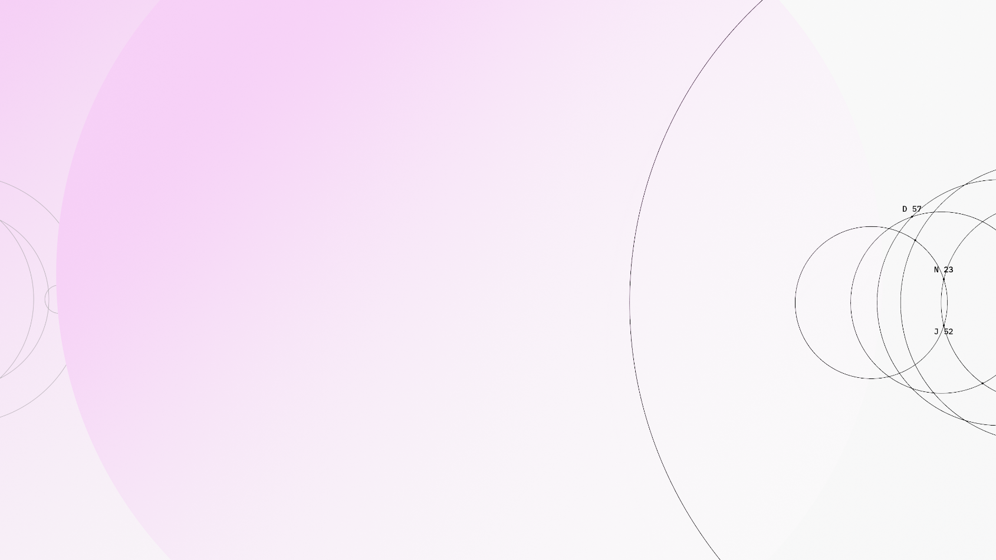


Slide 19
[ GINKGO DATAPOINTS POWERS AI ]
We built Ginkgo Datapoints to generate the data that underpins AI models in biotech. We provide data in a low-friction manner with your needs in mind.
[ DEAL TERMS ]
[ WAYS OF WORKING ]
Pricing Benefit from the economies of scale our automation offers with volume-based discounts. Deals are fee-for-service with no milestones or royalties.
Ownership You own the data.
Pilots We can do small, nimble pilot deals to start.
Flexibility We will carry out data generation campaigns to your needs, incl.: Size of dataset Cell lines & libraries Assays & readouts Flexible & secure data access
Speed We can return data in as little as 3 weeks.
Partnership Our highly skilled scientific team wants to collaborate with you.

Slide 20
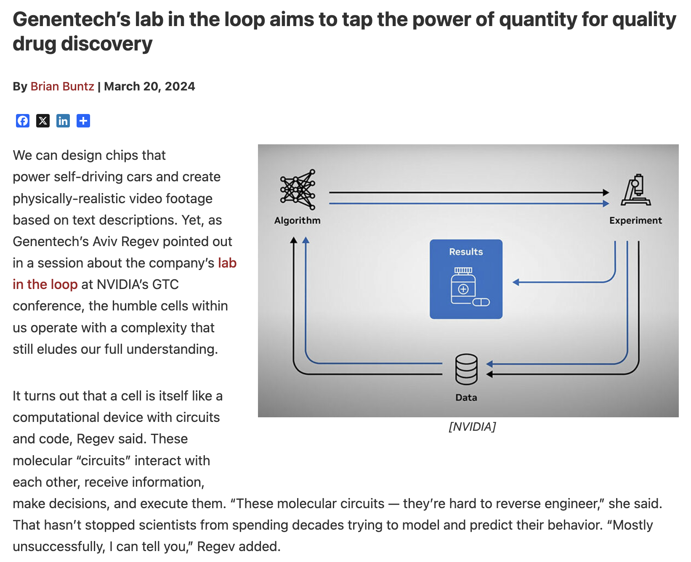



Appetite for these services is driven by interest in large data assets to enable AI in biotechnology
The alliance will bring “AI, the lab, and the clinic together to uncover otherwise inaccessible patterns in vast quantities of data, and to design experiments to test those patterns.”
AVIV REGEV Head of Genentech Research & Early Development (gRED), Global Research Technologies
“With AI in the loop today, we can get 80% of the value with 40% of the wet lab work, and that ratio will improve going forward.”
LEARN MORE
BEN MABEY Chief Technology Officer
LEARN MORE

Slide 21
The Data Foundry model complements (does not replace!) a classic research approach
Classic Research Approach
Foundry Research Approach
Flexibility
Infinite
Limited
Data density
Low
High
Approach
Hypothesis-driven / focused
Inductive / broad
Experiments
By-hand
Robots, software, by-hand
Team
Do-it-all scientists
Collaborating specialized teams
Use cases
Hypothesis testing
Proof of concept work
De-risking experiments
AI/ML model generation
Determining global maxima
Novel hypothesis generation
Complementary approaches that feed innovation

Slide 22

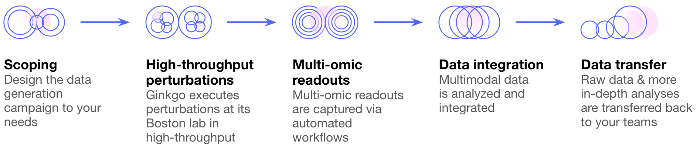
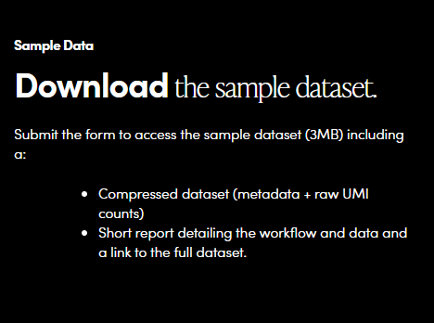
Beyond our traditional Solutions offerings, we’ve also launched two Datapoints products
Flexibility & Customization | Choose from cell types, compound library, data readouts.
End-to-End | We handle both perturbation and readouts. Tell us what you need, and we will deliver the data.
Scale | 10,000s of in vitro chemical and genetic perturbations in each cell type.
Speed | We deliver data in as little as 3 weeks.
Attractive Deal Terms | Fee-for-service only: no royalties, no milestones. And you own the data, always. Our version of an easy button.
Signed deals with leading tech bio companies and top 10 biopharma companies
LEARN MORE

Slide 23
[ GINKGO DATAPOINTS FUNCTIONAL GENOMICS ]
We can work with the cell types of your choosing
Cell types onboarded on drug-seq
Additional cell types onboarded on the Ginkgo platform
Cell type | Source organism | Tissue / organ
A549 | Human | Lung
HeLa | Human | Cervical
HEK293 | Human | Kidney
U2 OS | Human | Osteosarcoma
Normal Skin Fibroblasts | Human | Skin
Skeletal Myoblasts | Human | Skeletal
Vascular smooth muscle | Human | Aorta
Melanocytes | Human | Skin
PBMCs | Human | Blood
THP-1 | Human | Blood
CAR T cells | Human | Blood
Small Lung Airway Epithelial | Human | Lung
iPSC derived glutamatergic neurons | Human | Brain
Microglia | Human | Brain
HT-1197 | Human | Bladder
5637 | Human | Bladder
HT-1376 | Human | Bladder
Cell line | Source organism | Tissue / organ
Caco-2 | Human | Colorectal
HCT116 | Human | Colorectal
HepG2 | Human | Liver
HIEC-6 | Human | Intestine
Huh7 | Human | Liver
MCF7 | Human | Breast
Sk-N-AS | Human | Brain
SW480 | Human | Intestine
T24 | Human | Bladder
Jurkat | Human | Blood
Raji | Human | Bone
K562 | Human | Bone Marrow
ARPE-19 | Human | Epithelial
Expi-293f | Human | Kidney
LentiX-293T | Human | Kidney
Roadmap - to be onboarded by EOY
…and many more! We have worked with ~100 human cell types

Slide 24

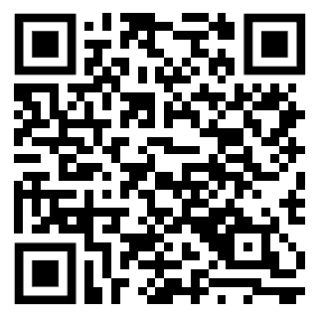
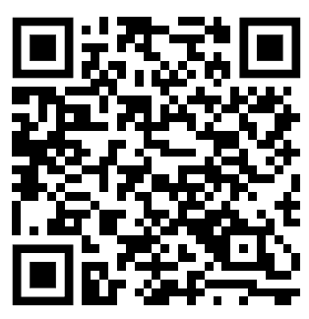
Download sample datasets
[ GINKGO DATAPOINTS FUNCTIONAL GENOMICS ]
We released sample perturbation datasets to the public
GDPx2
GDPx1
RELEASE DATE
December 2024
DATA PACKAGE
Metadata for a subset of 10 compounds and all controls
PDF outlining the experimental set up
CELL TYPES
Human melanocytes cells, aortic smooth muscle cells, dermal fibroblast, and skeletal muscle myoblasts
PERTURBATIONS
85 compounds, 6 concentrations, 4 replicates
SEQUENCING DEPTH
2M reads
READOUT
Transcriptomic (Drug-seq)
PLATE DENSITY
384-well plate
AVAILABLE DATASET SIZE (FASTQ)
~200 GB / cell type
RELEASE DATE
September 2024
DATA PACKAGE
Metadata for the 1264 compounds screen
Raw UMI counts for the subset of 20 compounds
PDF outlining the experimental set up
CELL TYPES
A459 cells (human non-small cell lung carcinoma, epithelial)
PERTURBATIONS
1,264 compounds, 2 concentrations, 4 replicates
SEQUENCING DEPTH
2M reads
READOUT
Transcriptomic (Drug-seq)
PLATE DENSITY
384-well plate
AVAILABLE DATASET SIZE (FASTQ)
60 GB

Slide 25

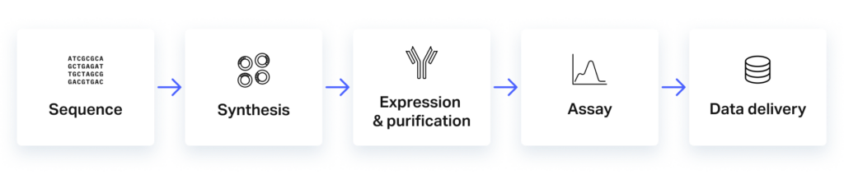
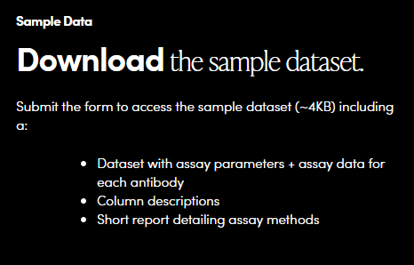
Beyond our traditional Solutions offerings, we’ve also launched two Datapoints products
Scale | Screen over 2,400 antibody sequences in parallel Enabled by our highly automated lab and over $1 billion of invested wet lab infrastructure
Breadth | Choose from 10+ developability assays across key biophysical antibody properties.
AI-Ready Data | Screen libraries including positive and negative sequences in standardized conditions and receive AI-ready data.
AI/ML Experience, Capabilities & Services | Combines decades of protein biophysics expertise with AI/ML-powered biological engineering Proprietary software accelerates automated data handling for faster insights Supported by a dedicated AI team
Simple & Easy Terms | Fee-for-service only: no royalties, no milestones. And you own the data, always. Our version of an easy button.
We take your antibody sequences as input, perform wet lab workflows in high-throughput, and return AI-ready datasets as output
We synthesize, express, and purify the antibodies, perform broad biophysical characterization, analyze and integrate the data
Return an AI-ready dataset to you
Deal signed with top 25 biopharma company
LEARN MORE

Slide 26

Standard Product Offering Ready
[ GINKGO DATAPOINTS ANTIBODY DEVELOPABILITY ]
[ DEVELOPABILITY CHARACTERIZATION ]
[ DELIVERABLE ]
Assays | Technology | Key Data Output
Core
Titer | Valita | mg/L
Target Binding (BLI) | Octet | K_{D}
Fragmentation (CE-SDS) | LabChip | %Purity
Aggregation (SE-HPLC) | HPLC | %HMW, %Monomer, Chromatogram
Biological
FcRn Binding | Lumit, BLI | K_{D}
Heparin Binding | HPLC | RT
Polyspecificity (PSP) | PSP or PAIA | PSP score or RFU
Biophysical
Thermostability (nanoDSF) | nanoDSF | T_{m} , T_{onset}
Self-Association (AC-SINS) | AuNP-based | Δλ_{max}
Self-Interaction (DLS-kD) | DynaPro III | kD
Hydrophobicity (HI-HPLC) | HPLC or PAIA | RT or RFU
Colloidal Stability (SMAC-HPLC) | HPLC | RT
Partners select assays from our set of standard products
Expanding to multiple antibody formats and assays to be responsive to customer needs

Slide 27
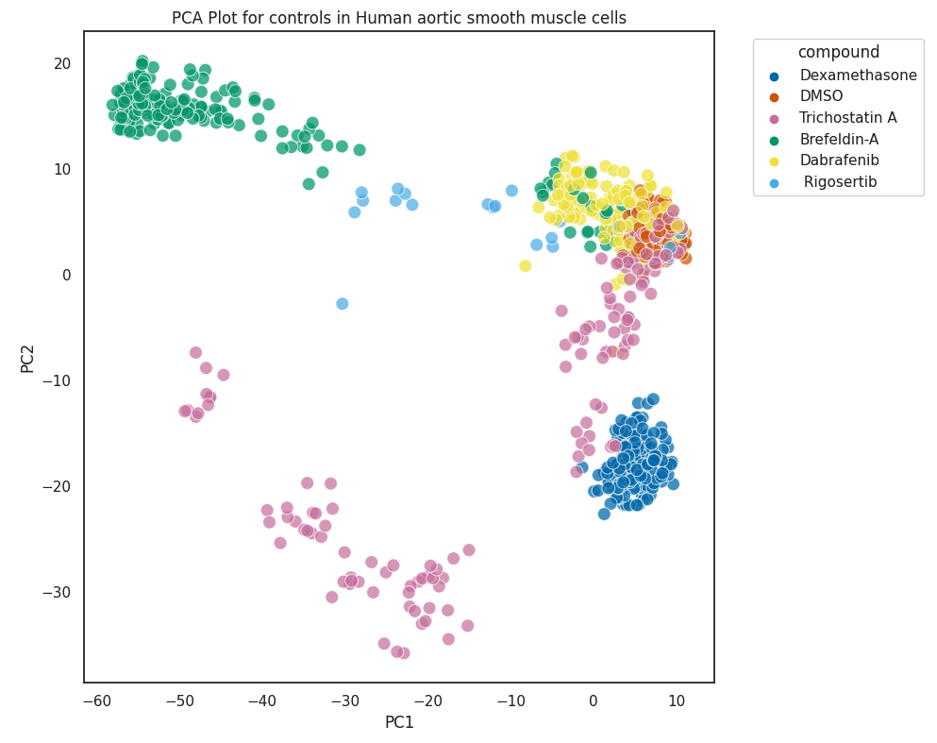
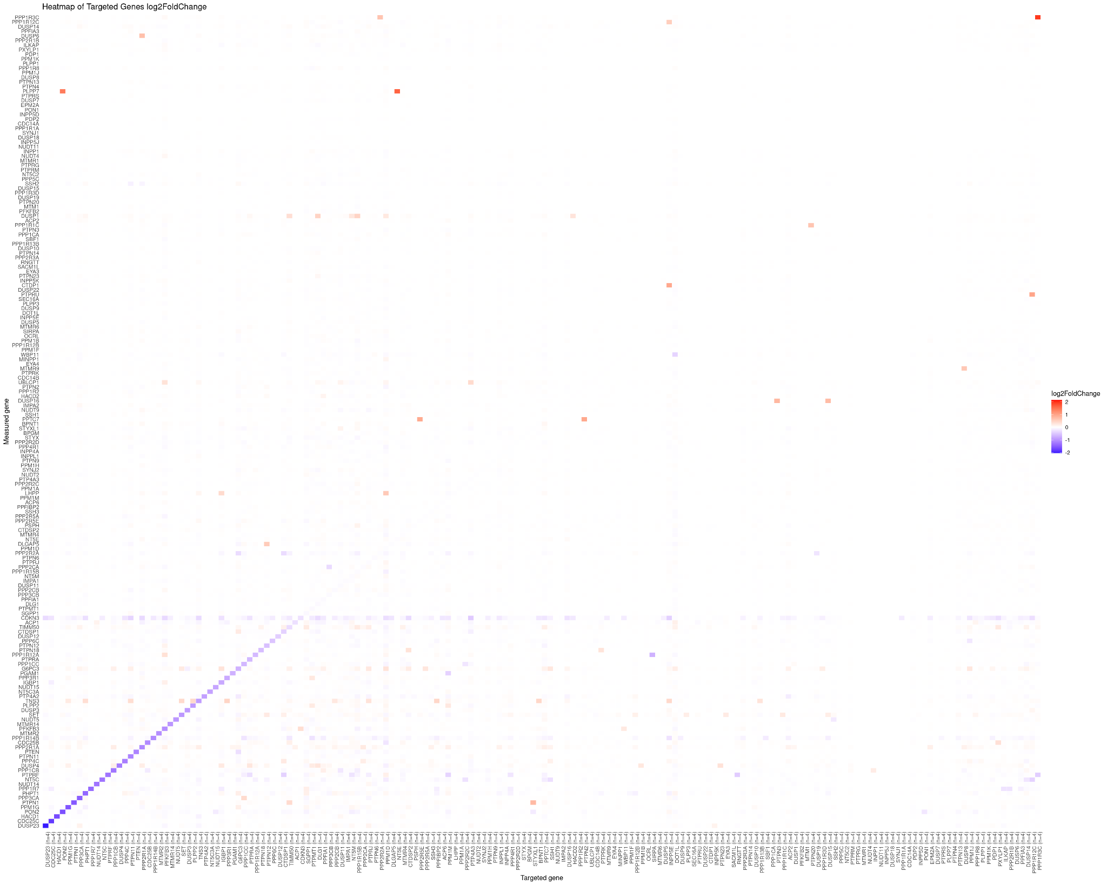
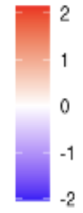
[ PROJECT EXAMPLES ]
We tailor data generation campaigns according to your R&D priorities and support cell types across multiple therapeutic areas
Example 1: Data for Oncology Target ID [ Arrayed chemical perturbations incl. Drug-Seq readout ]
Example 2: Data for Alzheimer’s Target ID [ Arrayed genetic perturbations (CRISPR-KO) incl. Drug-Seq + Imaging readout ]
Illustrative Deliverables
DETAILS
Chemical Perturbations of 2,000 compounds in 5 different cancer cell types at 1 concentration*, incl. Drug-Seq Readout
EXAMPLE CELL TYPES
A549, MCF-7, HCT116, HeLa, SK-MEL-28 and/or primary PBMCs
TIMELINE
10-11 weeks
DETAILS
Genetic Perturbations (CRISPR-KO) of 1,000 target genes across 3 cell types*, incl. Drug-Seq + Imaging readout
EXAMPLE CELL TYPES
CRISPR-ready, iPSC-derived neurons, astrocytes, and/or microglia
TIMELINE
9-10 weeks inclusive of time to design and order CRISPR KO guides
DRUG-SEQ:
Raw Fastq files
QC plot: total sequenced reads
QC plot: total reads mapped to reference
QC plot: percent of reads mapped to reference
QC plot: percent of rRNA removed before analysis
QC plot: number of genes recovered at >=3 UMIs
QC plot: PCA plot showing clustering between samples
UMI counts for all detected genes
HIGH-CONTENT IMAGING
All .tiff images
QC plot: image quality
QC plot: plot of plate-based controls
QC plot: plot of all conditions tested
Data will be available via an AWS S3 bucket.
* Assumptions: assumes 1 concentration in this example. Ginkgo can support several concentrations incl. dose response curves
* Assumptions: cells are Cas9-expressing and can be efficiently edited using Lipofectamine-based transduction

Slide 28
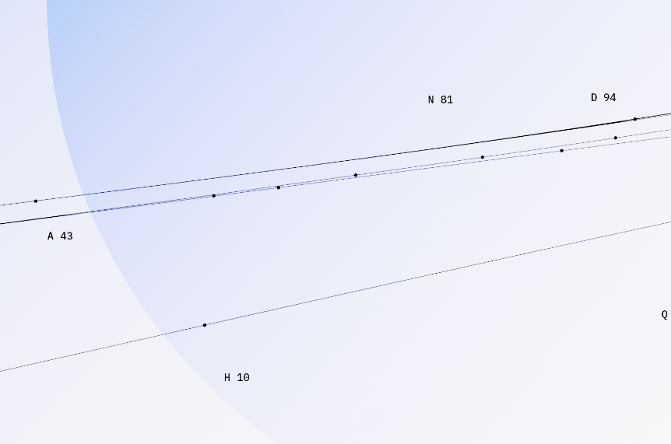
High-throughput RNA data generation Extended duration, more protein
Generate laboratory data to fine-tune and validate your mRNA sequence design models
RNA | HT Data Generation
Data generation assays
 | Throughput | TAT / Assay | Description | Included Options**
Stability | 20,000 / assay | 3 months | mRNA stability up to 72 hours | Huh7 or HEK293T cell lines 5’ UTR or 3’ UTR designs Up to 250 bp Ginkgo standard payload
Translation | 20,000 / assay | 3 months | Polysome fractionation profiling
Protein | 500 / week | 2 months | Image-based protein quantification | Multiple cell line options Luciferase or fluorescent protein
Immune Response | 500 / week | 2 months | Cytokine panel | THP1 or PBMCs 10 targeted cytokines
** Additional optionality (cell lines, in vivo contexts, therapeutic protein measurements, custom sequence designs) available for a fee. Please inquire with your project’s needs.
mRNA IVT specifications
Sequence Design | QC | Additional options for a fee
5’ Cap1, 120 nt poly-A tail Regular, m1Ψ nucleotides | Purification: SPRI beads Purity: 80-90% QC: UV-Vis + tape station | Custom cap, poly-A tailing, modified nucleotides LNP packaging Additional QC: Capping efficiency, dsRNA quantification, abortive transcription

Slide 29
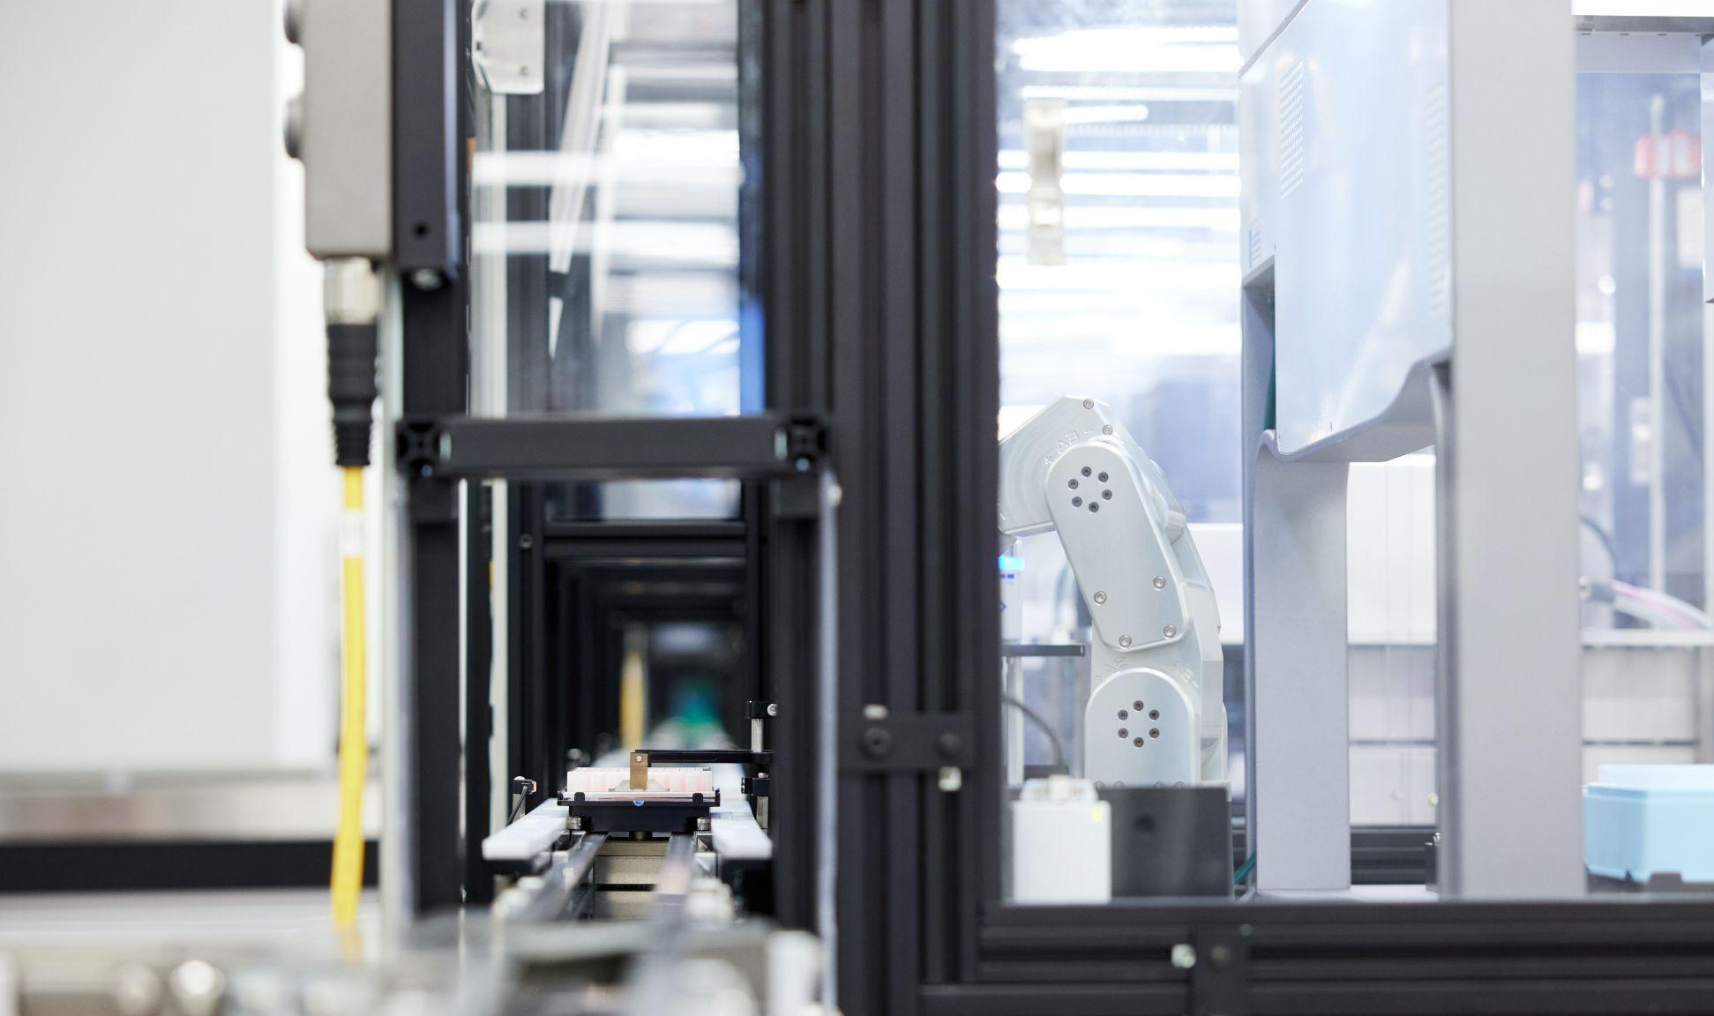


Slide 30
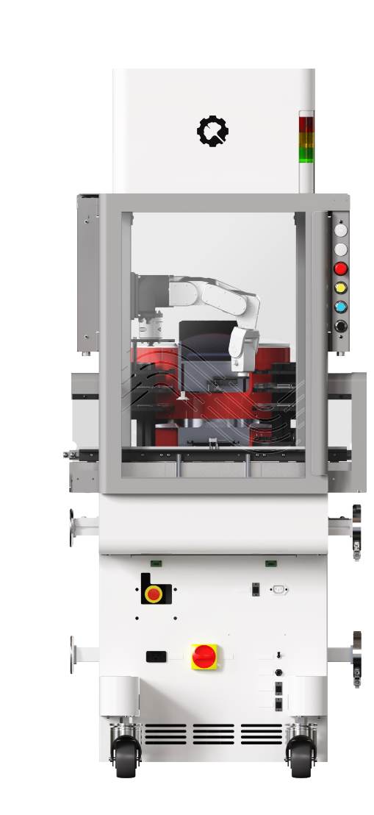
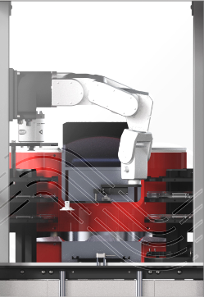
HARDWARE
Reconfigurable Automation Carts (RACs) are building blocks for the automated lab
A RAC is a standardized enclosure for integrating scientific instrumentation.
Rigorously engineered hardware designed with industrial components improves the reliability of integrated lab equipment and allows for unparalleled scalability and flexibility.
Optional HEPA Filter
Dedicated robotic arm improves reliability and throughput
Lab device of choice, from any application or vendor
Plate transport track
Quick connection points enable system reassembly in minutes, not days
Utility routing
(electrical, air, and data)

Slide 31
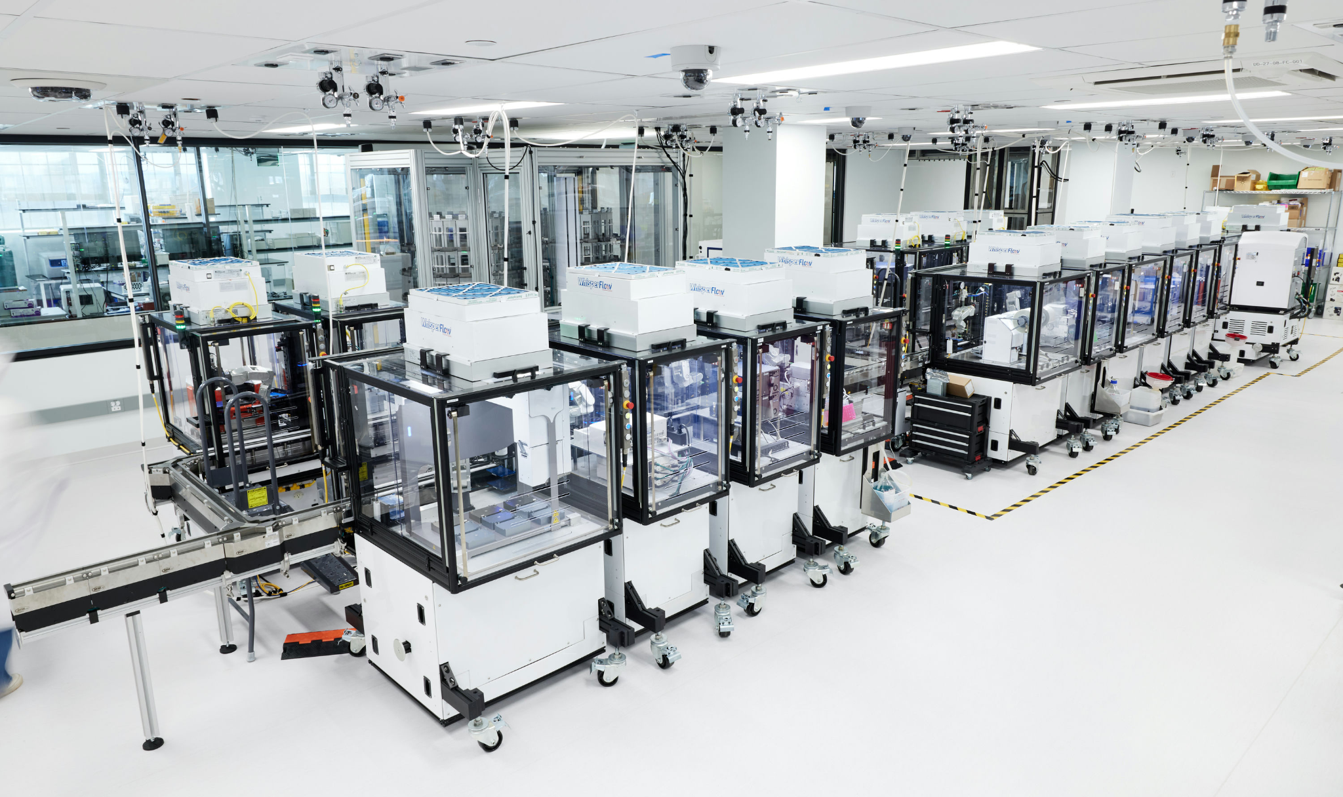
Collections of RACs integrate to become RAC Systems

Slide 32
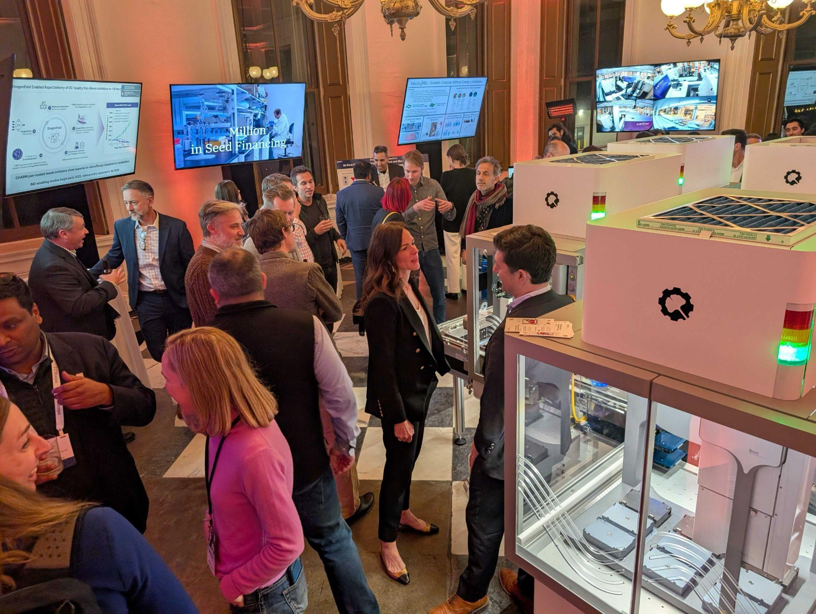
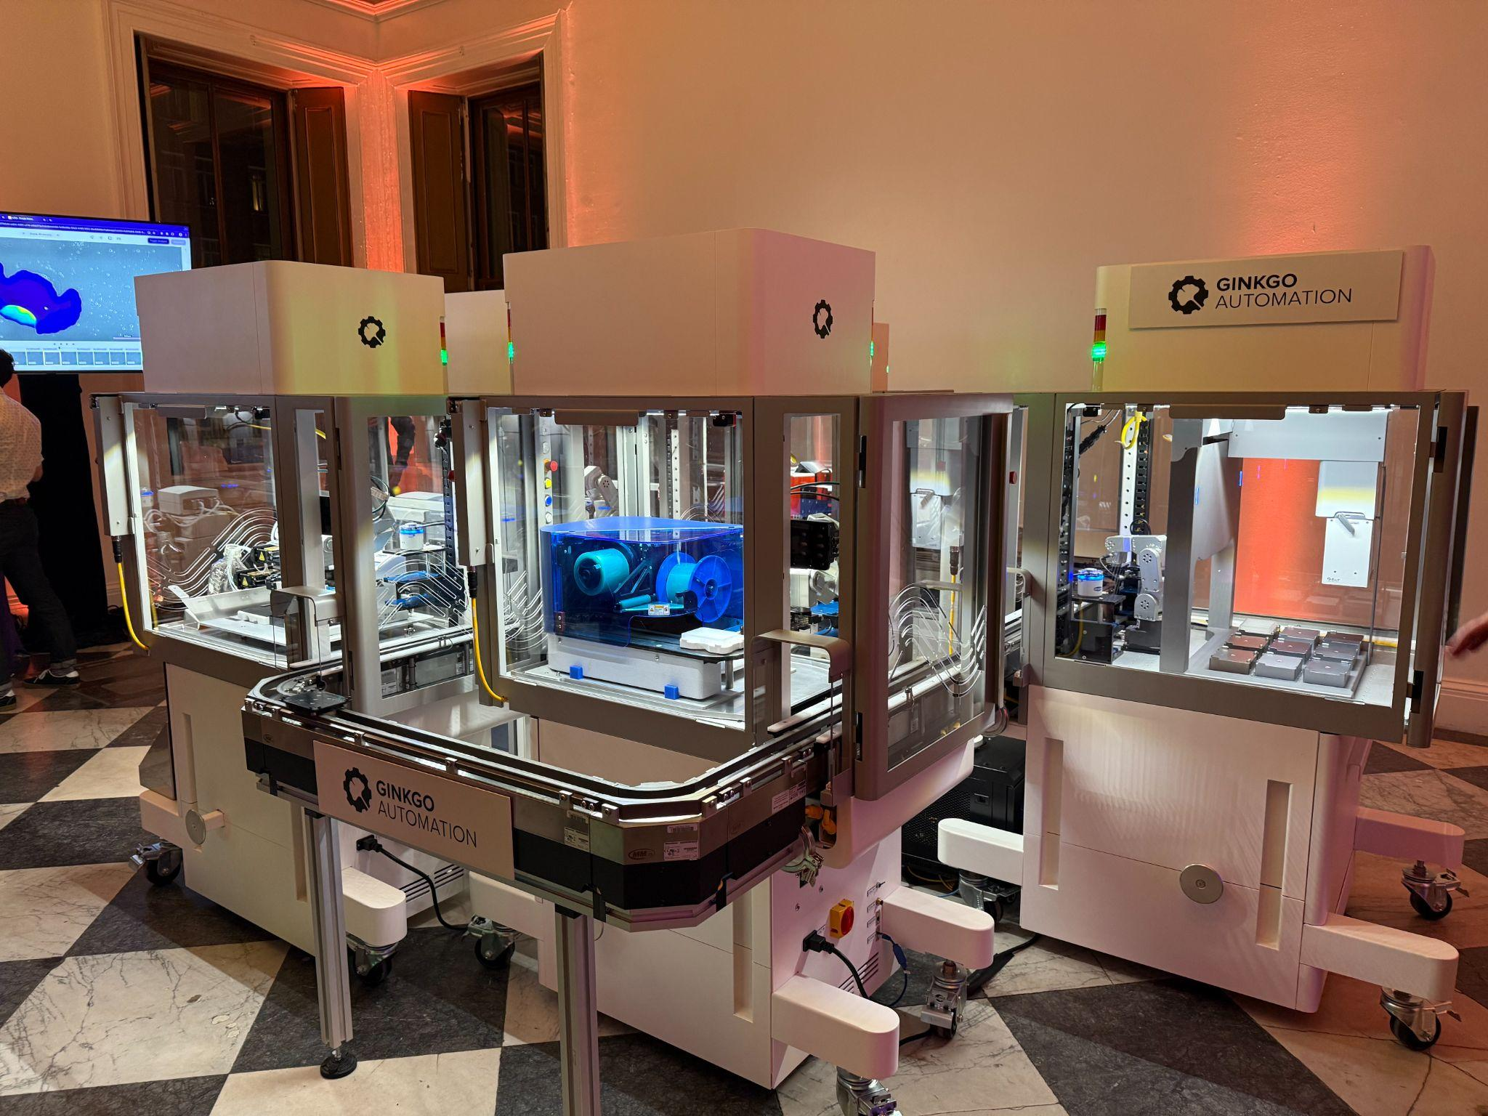

Slide 33
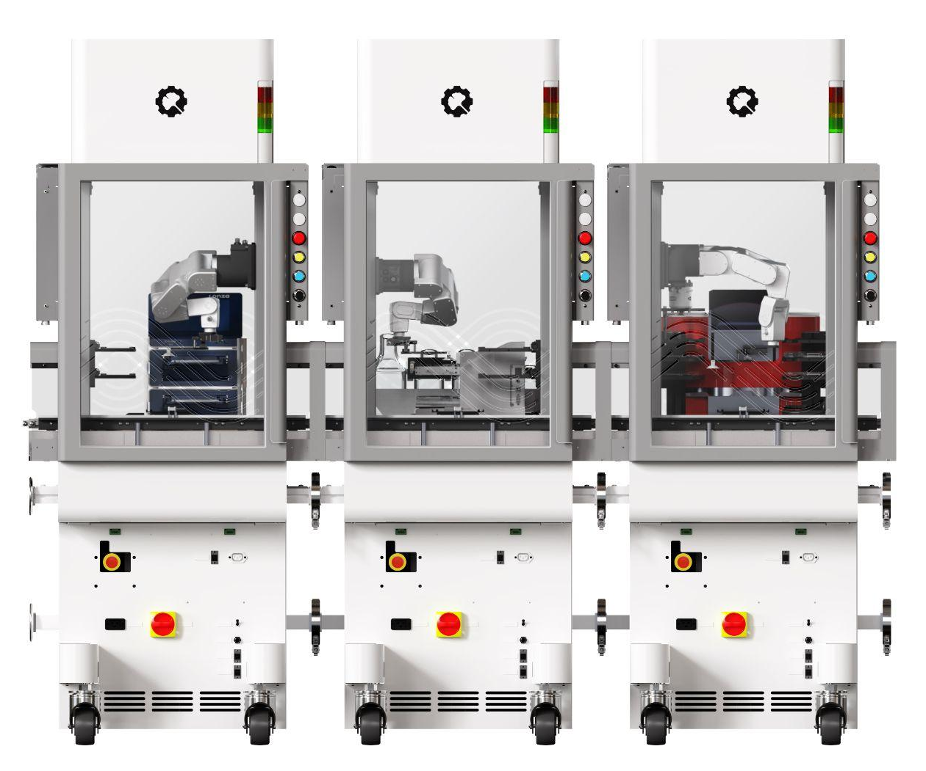
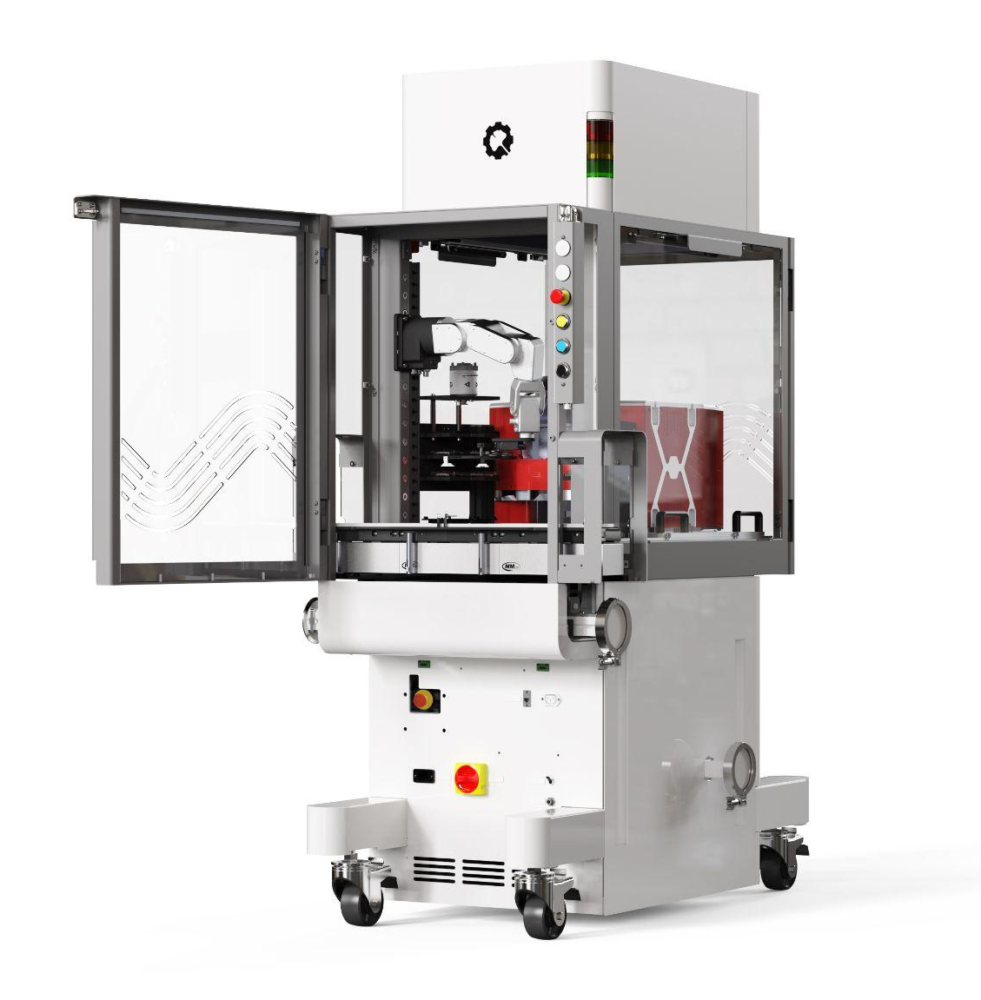
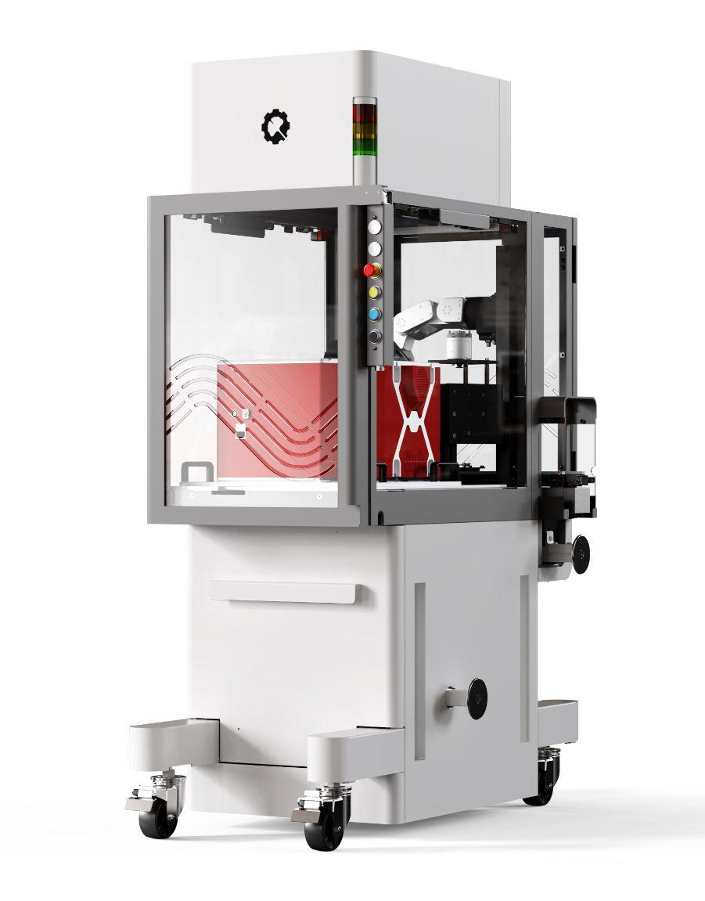
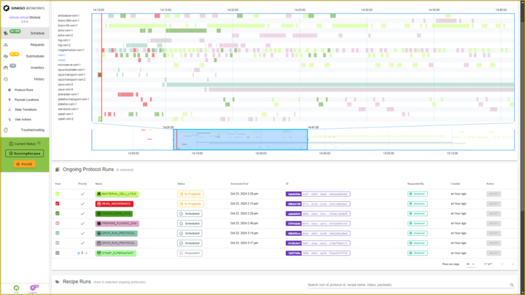
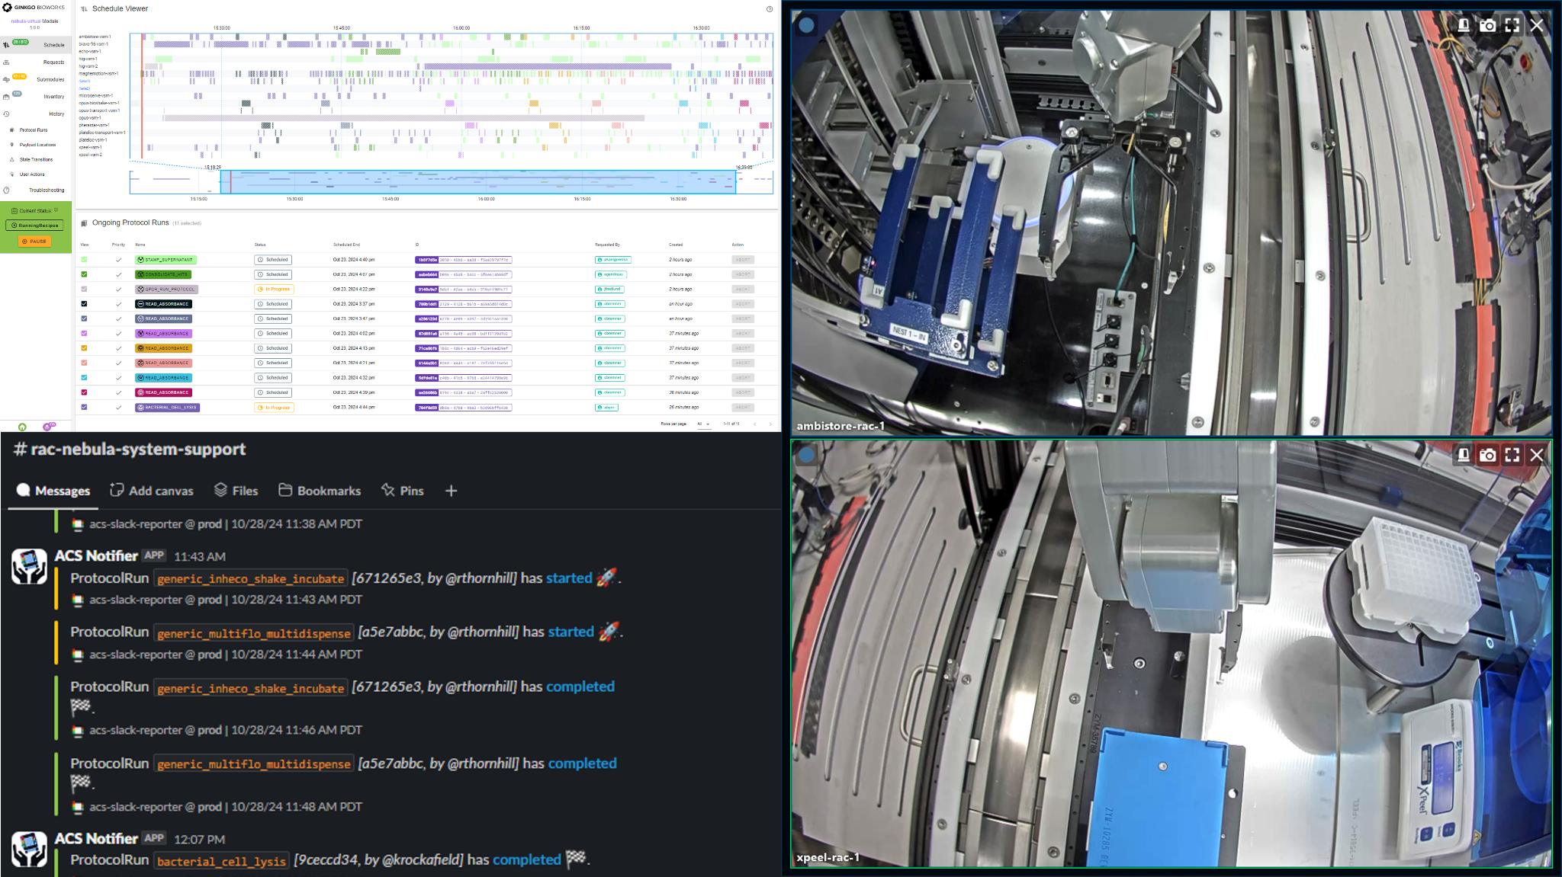
OFFERINGS
Our Integrated Offering
HARDWARE
Reconfigurable Automation Carts (RACs) Modular hardware building blocks that allow for (re)assembly of work cells within days or hours, not months.
CATALYST SUBSCRIPTION
Catalyst ACS Powerful, modular, web-based software to control interconnected instruments and RACs
Catalyst Flow 360-degree coverage, full-lifecycle, scalable support model that takes complete management responsibility for deployed automation systems. Enabled by our unique web-based architecture.
HARDWARE
Reconfigurable Automation Carts (RACs)
CATALYST SUBSCRIPTION
Catalyst ACS
Automation Control Software
Catalyst Flow
Managed Automation Solution

Slide 34
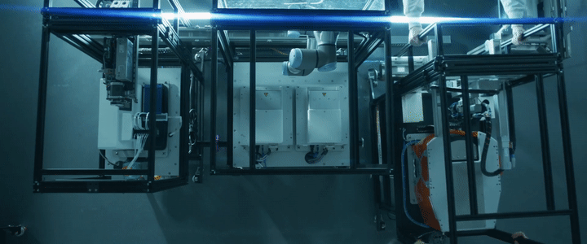

Reconfigurable Automation Carts are “Lego” building blocks for Lab Automation
We hope RACs can become a horizontal platform to standardize integrated lab automation across the industry.

Slide 35

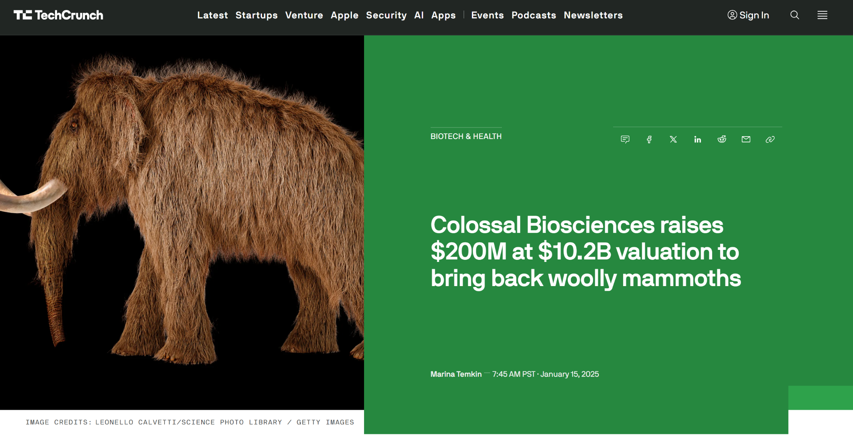


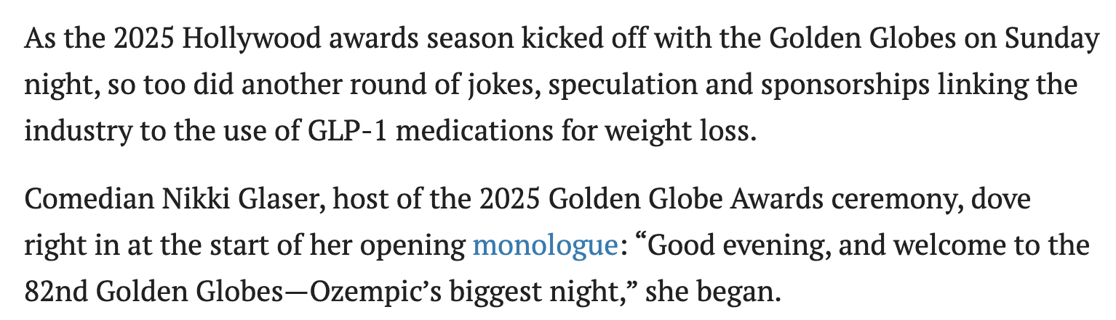
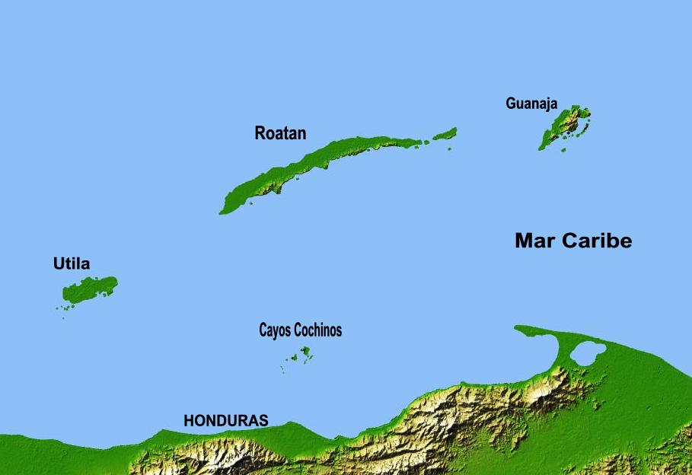

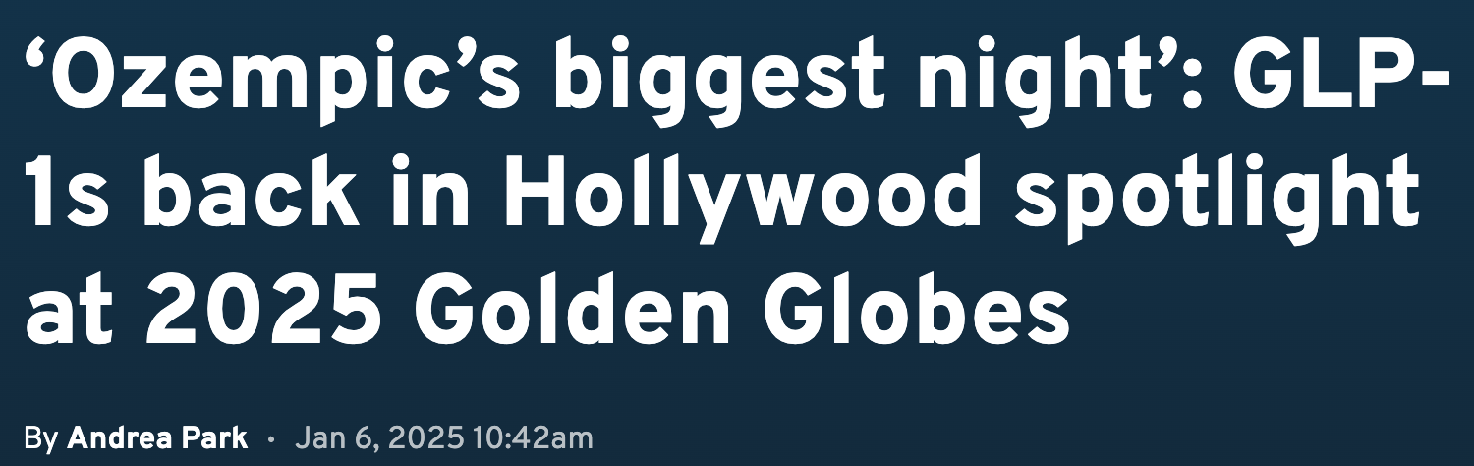
Biology is captivating ✨

Slide 36
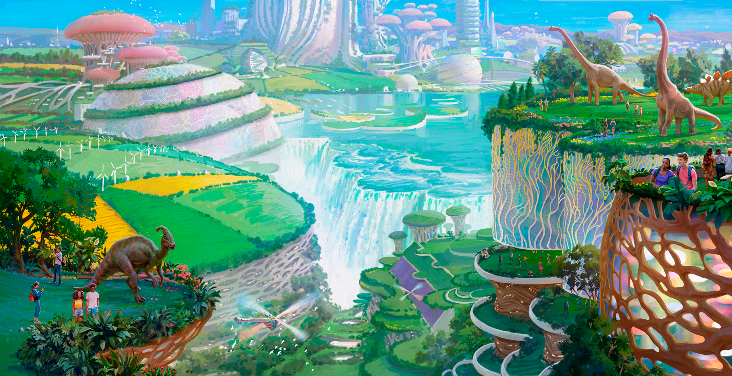

____________________
Let’s grow the world
we want to see
jason@ginkgobioworks.com
Notes:
IMPORTANT — You must add speaker notes on each slide.

Slide 37
www.ginkgobioworks.com
Notes:
IMPORTANT — You must add speaker notes on each slide.

