Slide 1
FemBloc®, a First-of-its-Kind Medical Solution for Permanent Birth Control and an Important Option for Women Post Overturn of Roe v. Wade
July 28, 2022 at 10:30 am EDT
KOL Event Presentation
FemBloc Permanent Birth Control is a product candidate for Femasys Inc.

Slide 2


Agenda
Kathy Lee-Sepsick, Founder, President
& Chief Executive Officer, Femasys Inc.
Welcome and Introductions
Femasys’ Development Programs
FemBloc®, a First-of-its-Kind Medical Solution for Permanent Birth Control in development
Dobbs v. Jackson Decision
Paul Blumenthal, MD, MPH, Director, Stanford Program for International Reproductive Education and Services (SPIRES)
Unmet Need for Family Planning Options
Dobbs v. Jackson Implications
FemBloc Experience (as investigator in trials)
Patient Access
Closing Remarks
Q&A

Slide 3
Key Opinion Leader: Paul Blumenthal, MD, MPH
Distinguished career in Obstetrics & Gynecology spanning close to 40 years
Professor Emeritus and Director of the Stanford Program for International Reproductive Education and Services (SPIRES) at Stanford University’s School of Medicine
Founded and directed SPIRES (an organization that provides quality assurance evaluation services and training to family planning focused NGOs and programs around the globe)
Former advisor to several domestic and international agencies:
  Gynuity Health Projects, Ipas, Pathfinder, Family Health International 360, Path, JHPIEGO Corporation, Planned Parenthood, and the World Health Organization
  Served as the Special Advisor to Ministry of Health and Family Planning of the Republic of Madagascar
Served for 10 years as Global Medical Director for Population Services International
Authored and contributed to hundreds of publications for medical journals ranging from cervical cancer screening to contraception access. He has conducted research on a global scale, including many diverse contraceptive methods.
Paul Blumenthal, MD, MPH
Director, Stanford Program for International Reproductive Education and Services (SPIRES)

Slide 4
Forward-Looking Statements
This Presentation contains "forward-looking statements" within the meaning of the Private Securities Litigation Reform Act of 1995 relating to our business, operations and financial conditions, including but not limited to current beliefs, expectations and assumptions regarding the future of our business, future plans and strategies, results of clinical trials and other future conditions. Words such as, but not limited to, "anticipate", "believe", "could", "estimate", "expect", "intend", "may", "plan", "potential", "predict", "project", "should", "will", "would" or the negative of those terms, and similar expressions that convey uncertainty of future events or outcomes, identify forward-looking statements.
These forward-looking statements reflect management's beliefs and views with respect to future events and are based on estimates and assumptions as of the date of this Presentation and are subject to risks and uncertainties. Moreover, the Company operates in a very competitive and rapidly changing environment. New risks emerge from time to time. It is not possible for management to predict all risks, nor can the Company assess the impact of all factors on its business or the extent to which any factor, or combination of factors, may cause actual results to differ materially from those contained in any forward-looking statements we may make. Given these uncertainties, you should not place undue reliance on these forward-looking statements. The Company qualifies all of the forward-looking statements in this Presentation by these cautionary statements. Except as required by law, the Company undertakes no obligation to publicly update any forward-looking statements, whether as a result of new information, future events or otherwise.
Statements contained herein are made as of the date of this Presentation unless stated otherwise, and neither this Presentation, nor any sale of securities, shall under any circumstances create an implication that the information contained herein is correct as of any time after such date or that the information will be updated or revisited to reflect information that subsequently becomes available or changes occurring after that date hereof.
Certain information contained in this Presentation relates to or is based statistical and other industry and market data obtained from independent industry publications and research, surveys and studies conducted by independent third parties as well as the Company's own estimates. The market data used in this Presentation involves a number of assumptions and limitations, and you are cautioned not to give undue weight to such data. Industry publications and third-party research, surveys and studies generally indicate that their information has been obtained from sources believed to be reliable, although they do not guarantee the accuracy or completeness of such information. The Company's estimates of the patient population with the potential to benefit from treatment with any product candidates the Company may develop include several key assumptions based on its industry knowledge, industry publications and third-party research, which may be based on a small sample size and may fail to accurately reflect the addressable patient population. While the Company believes that its internal assumptions are reasonable, no independent source has verified such assumptions.
This Presentation contains trademarks, trade names, or service marks belonging to other entities. The Company does not intend the use or display of other parties' trade names, trademarks or service marks to imply a relationship with, or endorsement or sponsorship of, or by these other parties.

Slide 5


Femasys: At-a-Glance
Who We Are
Financial Information
Femasys is a biomedical company aiming to meet women’s needs worldwide with a novel suite of products and product candidates that include minimally invasive, in-office technologies for reproductive health.
Headquarters: Suwanee, GA
Nasdaq: FEMY
IPO date: June 2021
Market Cap: $28.5 M
(as of 6/30/22)
Cash: $21.8 M
(as of 3/31/22)

Slide 6
Our Product Pipeline
Contraception Product Candidate
Research
Preclinical
PMA Clinical Studies
FemBloc®
Stage I
Safety
Stage II
Validation
Stage III
Pivotal
Permanent Birth Control and Ultrasound Occlusion Confirmation
THERAPEUTIC
Research
Preclinical
De Novo Clinical Study
FemaSeed®
Localized Artificial Insemination
Infertility Products and
Product Candidates
DIAGNOSTIC
Research
Preclinical
Approval
FemVue®️
Contrast-Generating Device
FemCath™️
Selective Delivery Catheter
Biopsy Product
Research
Preclinical
Approval
FemCerv®
Endocervical Tissue Sampler

Slide 7




Strong Global IP Portfolio
Our Patent Estate Encompasses Utility and Design
Directional Delivery (dual or single)
to Fallopian Tubes
Biopolymer Composition for Tubal Occlusion
Contrast Generating Ultrasound Visible
Tissue Sampling for Cancer Detection
FemBloc, FemaSeed, FemCath
FemBloc
FemVue
FemCerv
Occlusion Confirmation for FemBloc
130+ patents ISSUED globally; OVER 40 pending

Slide 8

Our Technologies Provide a Continuum of Care
In-office, minimally invasive solutions
Shared delivery platforms leverage existing skill sets

Slide 9
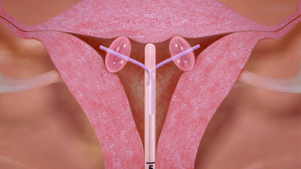
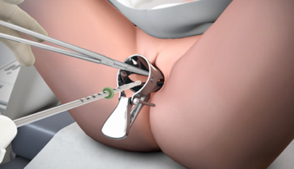
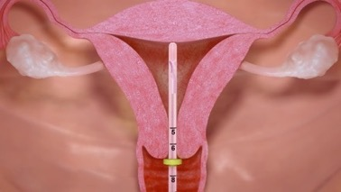
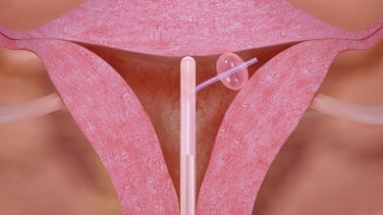
Our Novel Biomedical Procedures in Development: Simple and In-Office
Specified, precise delivery to fallopian tubes (i.e., biomedical material, sperm or therapeutic agents)
Dual Placement
Common minimally invasive technique
(i.e., intrauterine catheters, IUD)
No anesthesia and no incisions
No special skillset and no capital equipment
No cannulation of tube
Single Placement

Slide 10
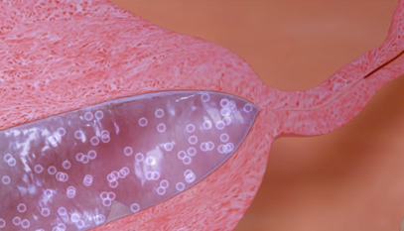
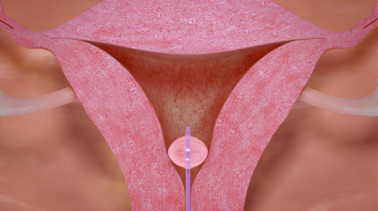
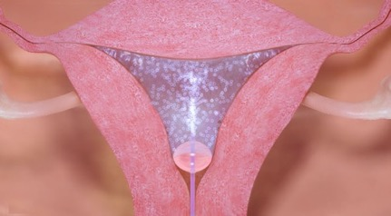
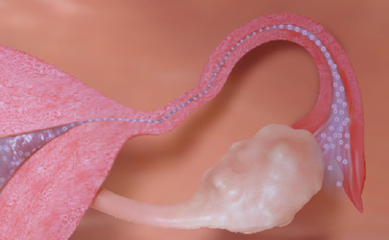
Our Companion Ultrasound-Based Diagnostics: Simple and In-Office
Contrast generation for screening and occlusion confirmation for use with our novel biomedical procedures
Real-time imaging result
Balloon catheter inserted
common technique
Deliver saline-air contrast
for tubal evaluation
Occlusion
No Radiation
No X-Ray Dye
No Referral to Radiology Center
Patency

Slide 11

FemBloc®
Permanent Birth Control + Ultrasound Occlusion Confirmation
First and only non-surgical, in-office, permanent birth control option in development with the potential to be the safest and most natural approach at half the cost of the long-standing surgical alternative
First in-office ultrasound approach for confirmation of procedure success
FemBloc Permanent Birth Control is a product candidate for Femasys Inc.

Slide 12


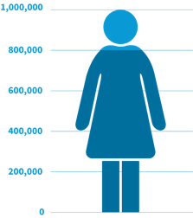

Permanent Birth Control Alternatives: Unmet Need (U.S. only)
>13M women no longer intend to have children
800,000 women choose surgical tubal ligation as a form of permanent birth control every year
More than 100 years of stagnant innovation for permanent birth control
Since surgical tubal ligation has been performed since the 1880’s and remains the most common option for women who want permanent birth control.
>12M use non-permanent birth control, long-term

Slide 13
FemBloc: Expected Competitive Advantages Over Existing or Previous Birth Control Options
 |  | On-Market Solutions |  |  | Off-Market
 | FemBloc | Surgical Tubal Ligation* | IUD (Reversible) |  | Essure®*
Permanent | ✔ | ✔ |  |  | ✔
Office Procedure | ✔ |  | ✔ |  | Some
No Special Capital Equipment | ✔ |  | ✔
No Anesthesia | ✔ |  | ✔
No Coil Implant/ Clip | ✔
No Hormones | ✔ | ✔ |  |  | ✔
One-Time Treatment Cost | ✔ | ✔ | Multiple IUDs |  | ✔
Worldwide Applicability | ✔ | Varies | ✔
*6% failure rate for laparoscopic sterilization (tubal ligation) and 5% failure rate for hysteroscopic sterilization (Essure), reported in published study as higher than expected (Fertility and Sterility, 2022)
Essure® is a registered trademark of Bayer Healthcare (Conceptus) and, as of December 2018, no longer a marketed solution.

Slide 14
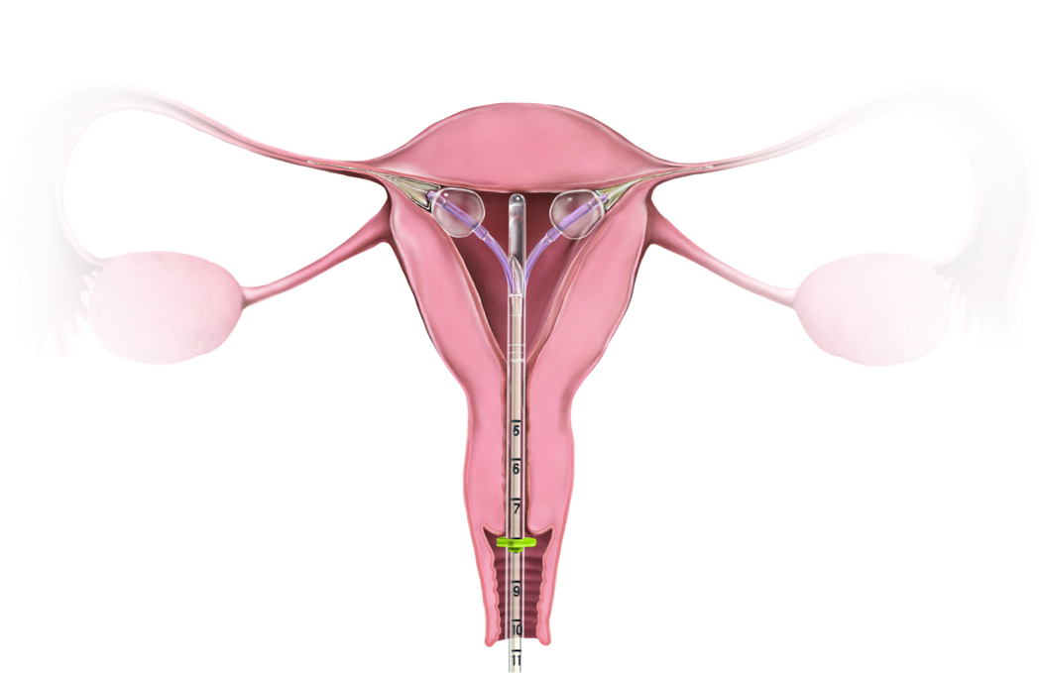
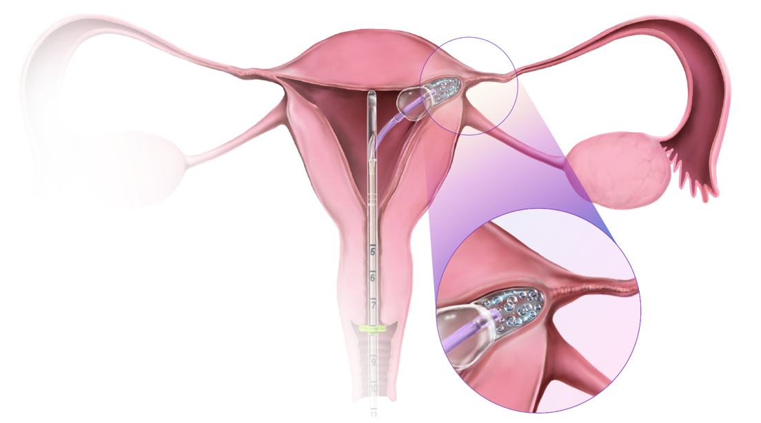
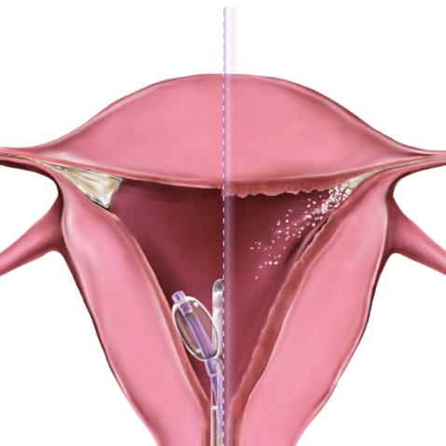
FemBloc Permanent Birth Control in Development
The first and only non-surgical, in-office approach
FemBloc Treatment
Occlusion Confirmation
No Permanent Implant – Scar Tissue Closes Tubal Lumen
Companion ultrasound procedure exclusive to FemBloc - confirms procedure success
Biopolymer solidifies
Biopolymer degrades
Biopolymer is designed to be expelled within 3 months
Balloon at tubal opening without cannulation
3 Months
Blockage
Saline-air contrast confirms blockage

Slide 15
FemBloc Clinical Studies for Pre-Market Approval (PMA)
Early Clinical
Stage I: Safety
Stage II: Validation
(on-going)
Stage III: Pivotal
(pending)
Evaluated Delivery &
Biopolymer Effectiveness
No Serious AEs Reported
Selection of Confirmation
Test for Pivotal
Safety & Effectiveness
of FemBloc
✔
✔
Summary:
n=93 subjects received planned hysterectomy
Subset with histopathology demonstrating biopolymer tissue reactions
No serious safety events reported
Summary:
n=183 subjects being followed for 5 years
Patients found procedures highly tolerable
96% physicians assessed procedure to be extremely/ very simple
99% physicians assessed easier than tubal ligation surgery
Goals:
IDE approval of study design
(multi-center, unblinded prospective study);
First-mover advantage utilizing previous FDA approved third-party study designs:
  primary endpoint of pregnancy rate at 1 year post confirmation test
  safety follow-up 2-5 years post-market
Goals:
n=50 subjects receive two confirmation tests to allow selection of ultrasound or radiology test
Evaluate adequacy of improvements to procedures, products and training
FILE IDE EXPECTED Q1 2023
ENROLLMENT COMPLETION EXPECTED Q3 2022
SITE RECRUITMENT UNDERWAY

Slide 16
FemBloc: Majority AEs Were Mild and Occurred at Time of Procedure (n = 183 subjects)
94% AEs related to device/ procedure occurred within 7 days of procedure
165
No SAEs
75% AEs mild
53
27
12
8
5
1
2
2
3
FemBloc Treatment
(90 days)
Patients are being followed for 5 years, with first subjects approaching 4-year follow-up

Slide 17
FemBloc: Most Common Reported AEs (>1%) Were Related to Bleeding/Spotting or Pelvic Pain/Cramping
Mean pain/ discomfort score* out of 10 as reported by patient:
4.3 for FemBloc treatment and 3.0 for confirmation
Bleeding/Spotting (41.5%)
Pain/Cramps (38%)
Other
28%
24.8%
10.3%
2.1%
1.1%
8.9%
1.1%
1.8%
4.3%
*Visual Analog Scale (VAS) from 0-10 was used, where 10 was the highest measure of pain/discomfort.

Slide 18
Permanent Birth Control Market Opportunity (U.S.)
72 M Reproductive Aged Women
Tubal Ligation Surgery
Hormones
Most Invasive/ Most Reliable
Least Invasive / Least Reliable
Condoms
Near-Term Target Market
$2B Annual
Market Expansion Opportunity
$20 B Total
Includes women (and partners) choosing permanent birth control annually (~1.3M)
Includes women using non-permanent options but are candidates for permanent birth control (>12M)

Slide 19
FemBloc: Improved Health Economics
Permanent One-Time Cost Breakdown
FemBloc Efficiencies
$6,000*
In-office procedure expands practice services
Can perform multiple procedures in same room
Quick to perform; ease of room turnover
Patient resumes normal activities
Facility
Anesthesia
Pre-Op
Est < ½ cost of
Tubal Ligation
Anesthesia
Post-Op
Cost of FemBloc System
Physician / Practice
Planned Parenthood 2019, https://www.plannedparenthood.org/learn/birth-control;
Doximity 2019; U.S. Bureau of Labor Statistics, 2019.
Physician

Slide 20



FemBloc: Clear Reimbursement Path
3 reimbursable visits
1
2
3
Counseling/Eligibility
FemBloc Treatment
FemBloc Confirmation
1+ Days
3 Months
In-office/ TeleVisit
(required for permanent birth control)
In-office procedure
In-office test
(ultrasound)
Existing CPT codes
Category covered (ACA)
Cat III code approved
Cat III code approved

Slide 21
Investment Highlights
Biomedical Company Disrupting the Approaches to Women’s Health with Proprietary Diagnostic and Device Solutions in Development
Addressing Multi-Billion Dollar Global Market Opportunities in Infertility and Permanent Birth Control With Differentiated and Improved Approaches
Clear Reimbursement Path with Limited Competition Yields Improved Patient Care and Health Economics
Woman-Founded and Led, Experienced Leadership Team with Concentrated Development Expertise
Commercial-Readiness Based on In-House CMC and Device Infrastructure; Audited Systems Allow for Risk Mitigation
130+ Patents Filed Globally
Cash Runway of at least 12 months

Slide 22

Family Planning Post Roe v. Wade Overturn
Paul Blumenthal, MD, MPH
Professor Emeritus and Director of the Stanford Program for International Reproductive Education and Services (SPIRES) at Stanford University’s School of Medicine

Slide 23
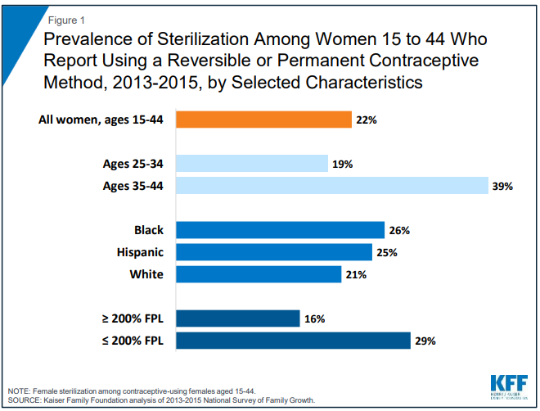
Historical Context
Sterilization is a permanent method of contraception, and is the most commonly used method in the U.S. and worldwide.
  Rates have declined over past decade. May be due to waiting period for women on Medicaid and availability of clinicians to provide.
  Largest decrease is users of sterilization from 37% to 28% with lower income driving the decline (largest increase in use was LARC from 6% to 14%) from 2008-2014*; KFF reports 22% prevalence of sterilization (Dec 2018)
Insurance Coverage - Affordable Care Act of 2010
  Federal guarantee specifically requires female sterilization coverage, without any out-of-pocket costs to the patient
  Federal policy does not include vasectomy
*Kavanaugh et al., Contraception 2018

Slide 24
800,000 Women Choosing Permanent – others using temporary method
12M
Not interested
in children
4M (35%)
LARCs
3M (25%)
Pill
2M (18%) Condom
1M (8%)
Other Hormone
2M (14.5%)
Other Methods
Source:
“Table 4: Number of women aged 15-44 currently using a method of contraception during month of interview, and percent distribution, by method, according to martial or cohabiting status, parity, and intent to have more children: United States, 2002 and 2011-2013.” Daniels K, Daugherty J, Jones J, Mosher W. Current contraceptive use and variation by selected characteristics among women aged 15-44: United States, 2011-2013. National Health Statistics reports; no 86. Hyattsville, MD: National Center for Health Statistics. 2015.
“Figure 2: Percent Distribution of women aged 15-49, by current contraceptive status: United States, 2017-2019.” Daniels K, Abma JC. Current contraceptive status among women aged 15-49: United States, 2017-2019. NCHS Data Brief No. 388. Hyattsville, MD: National Center for Health Statistics. 2020.

Slide 25




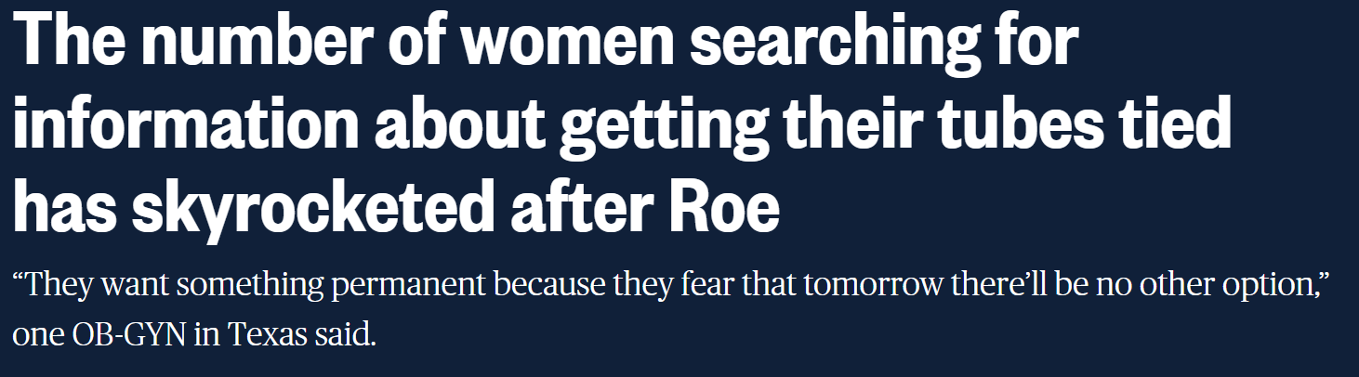

Women are Requesting Sterilization
The demand for sterilization is increasing and we don’t see this reversing in the foreseeable future
More women are searching online for physicians who perform the procedure
  Patient autonomy is important as long as there is not significant risk of harm.
  Urgency and certainty may increase with decision to get sterilized.

Slide 26
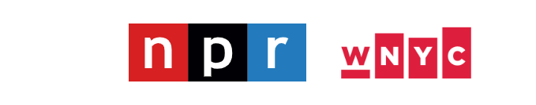
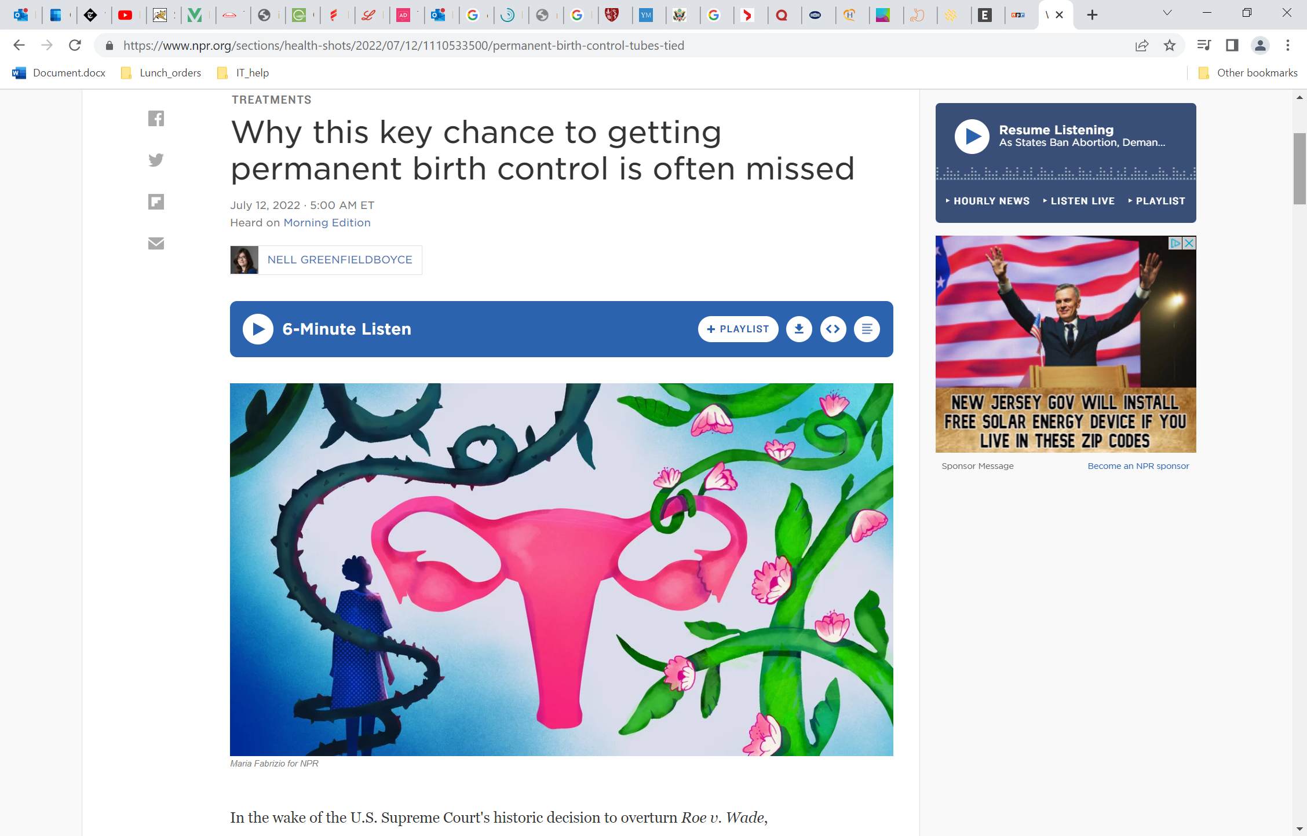
50% of Women Request Sterilization Post-Partum are Denied
Reasons for denial are typically logistical or bureaucratic in nature
  Hospitals and especially L&D are not in the contraception business, they are in the baby business
  Sterilization procedures low priority
  Operating rooms are expensive places to do business and in short supply. Sterilization procedures at low end of OR reimbursement and pro-fees. (e.g., not being able to accommodate surgery due to operating rooms that are at capacity or due to problems with patient intake)
40-75% women plan to use IUD postpartum do not obtain
An office-based procedure (FemBloc) may increase adoption and access

Slide 27

The Only “Permanent Birth Control” Option that Currently Exists is Not as Effective as Once Thought
Fertility and Sterility, March 2022
Laparoscopic Sterilization (surgical tubal sterilization):
n=23,965; Pregnancy rate: 5.57%
Hysteroscopic Sterilization (Essure - not on the market):
n=5,906; Pregnancy rate: 4.74%
Study Conclusion:
Pregnancy rates after female sterilization are higher than expected.
Women should be informed that after the procedure, women typically face at least a 6% chance of pregnancy in the next 5 years.

Slide 28
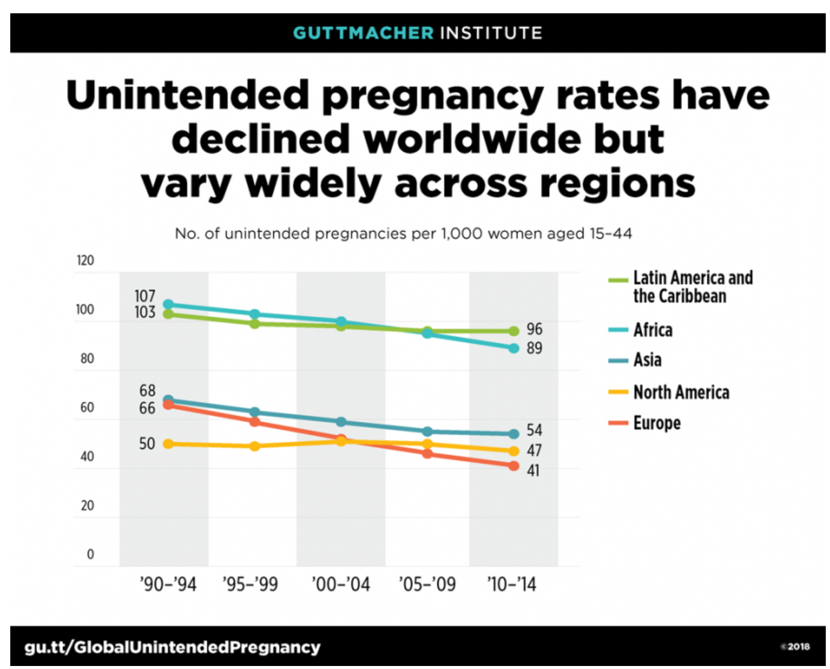
Unintended Pregnancy
Unacceptably high overall rate of approximately 50% in U.S. for past 20 years
  Need to increase access to reliable contraceptive methods
  Long-acting reversible contraception (LARC) - such as IUDs and single-rod implants - has been slowed by the difficulties hospitals and gynecologists encounter in receiving reimbursement and payment for devices and services separate from the global fee for delivery
Unintended pregnancy persists as a major public health problem

Slide 29
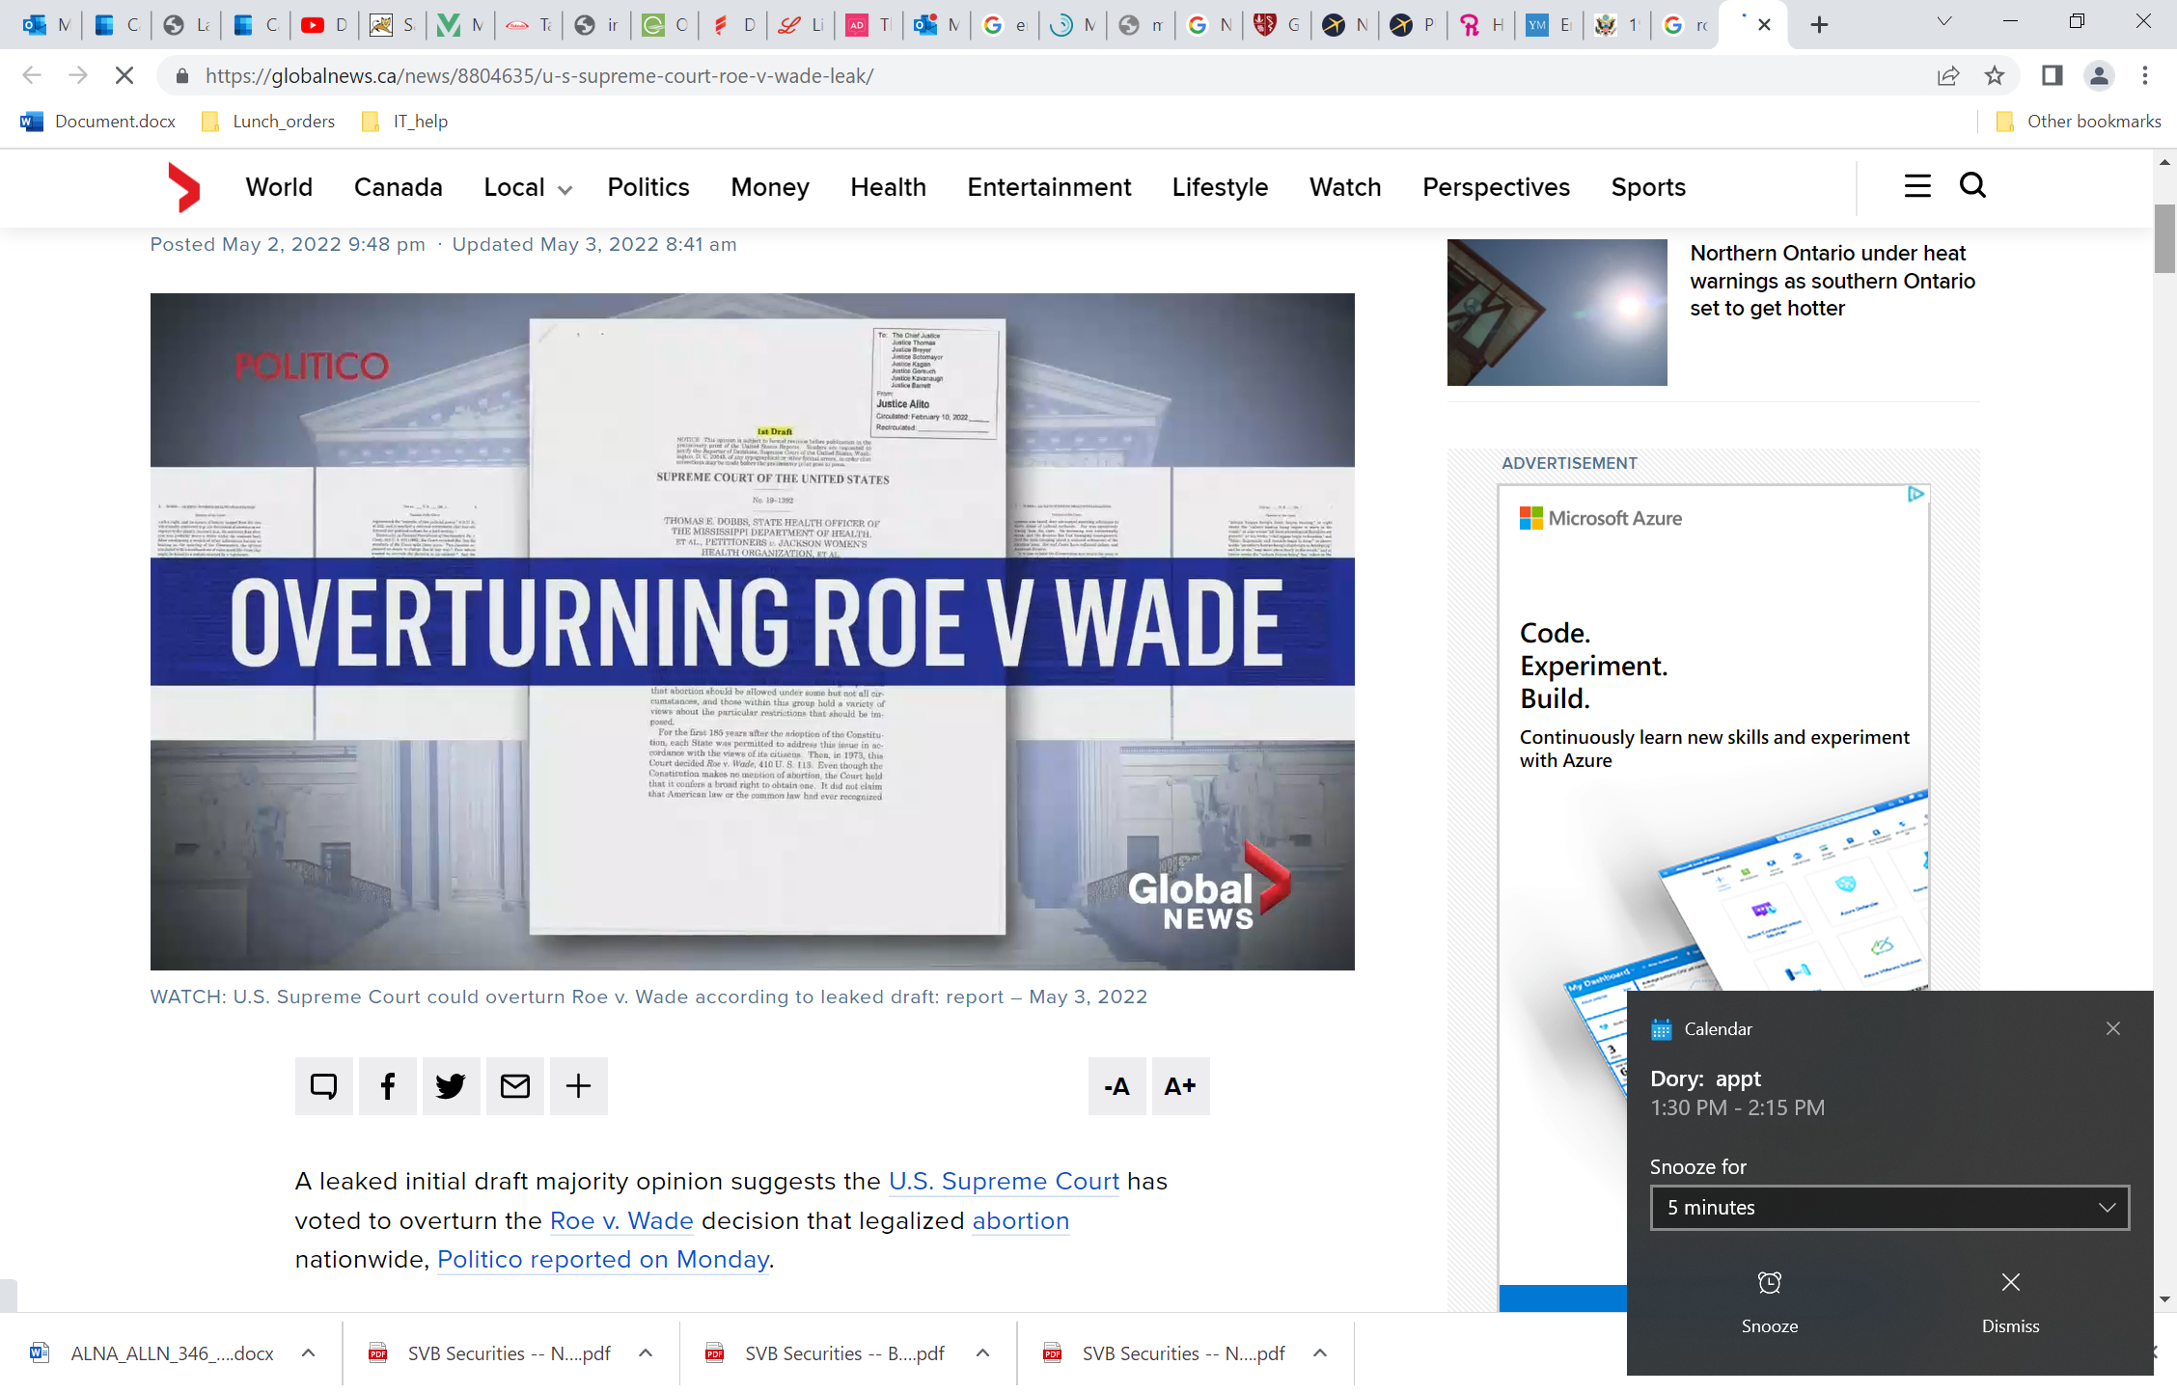
Where Do We Go From Here?
There’s no question that abortion is a controversial, sensitive, and, most importantly, a personal issue. However, the Supreme Court decision on June 24th sent us backwards in time.
Women’s options need to be both preserved and expanded. Our patients' voices need to be heard. As far as contraceptive rights are concerned, we need to ensure that protections are preserved, and that women’s reproductive rights and options are not further reduced.
OF

Slide 30
The Unmet Need for Women:
Options for Family Planning
Although tubal ligation has been performed for over a century, women will benefit from an in-office approach that avoids the risks and discomforts associated with incisions, general anesthesia and surgery. FemBloc may expand much needed options for women seeking permanent contraception.
30

Slide 31
Non-Surgical and Transcervical:
A Longstanding Goal
A win-win for physicians and their patients
Gynecologists can perform:
  Part of their skillset (like an IUD placement)
  Can teach the procedure in residency
Can easily incorporate into office logistics:
  No anesthesia
  No special equipment
  Few minutes to perform
Game changer for practices and their patients:
  Convenient in-office
  No cost to patient through ACA
  Notable reimbursement expected for physician/ practice
“I performed FemBloc as part of the clinical trial and found the procedure
easy to perform in my office and well tolerated by my patients.”

Slide 32
FemBloc would make Permanent Contraception Much More Accessible
Non-surgical will allow the demand to be met versus the cost and accessibility of surgical
Global impact (Affordable Care Act, etc.)
Historical reimbursement level expected providing incentive for in-office
Avoidance of the hospital and related bureaucracy

Slide 33
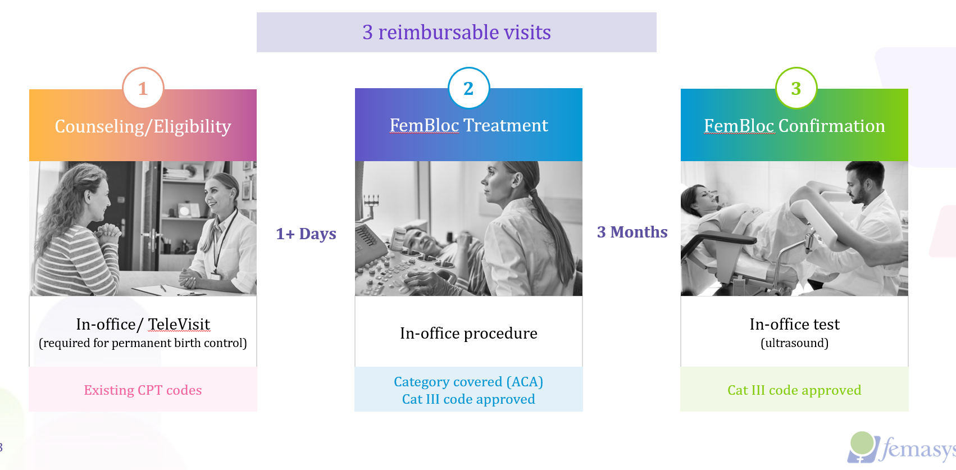
FemBloc: Clear Office Logistics
Source: https://www.femasys.com

Slide 34
Femasys’ Role in a Post-Roe v. Wade World
Providing potential options for women in areas with limited choices
Demand for permanent birth control option will likely continue to increase
  Femasys’ FemBloc could provide women with an ideal choice; I am not aware of anyone else working in this area
Debate over when conception occurs/IVF restrictions¹
  Femasys’ FemaSeed (selective artificial insemination) could serve an important role for providing a fertility option
¹ Source: https://www.nytimes.com/2022/07/05/health/ivf-embryos-roe-dobbs.html

Slide 35
Thank you
Dr. Paul Blumenthal
Stanford University

Slide 36
Closing Remarks

Slide 37



Femasys FemBloc Has Potential to be a Game-Changer for Women
Large Market
Growing demand with overturn of Roe v. Wade
Unmet Need
Only surgical tubal ligation available (costly, difficult to access, lower effectiveness rate)
Designed with Patient and Physician in Mind
For the Patient
For the Physician
In-office, convenient and quick
Safe, non-implant approach
No cost through ACA
In-office technique leverages existing skill set
Easy to incorporate in practice
Clear path to reimbursement

Slide 38




Femasys is Prepared for Execution
Clear Clinical Path to FDA Approval
Clear Reimbursement Pathway
Commercial Expertise
MFG Ready
Full manufacture facility with ability to scale and transfer
Sales Ready
Building commercial infrastructure before salesforce with FDA cleared products for GYNs

Slide 39
Q&A

Slide 40
FemBloc®, a First-of-its-Kind Medical Solution for Permanent Birth Control and an Important Option for Women Post Overturn of Roe v. Wade
July 28, 2022
KOL Event Presentation
Contact:
Investors: Chuck Padala
IR@femasys.com
Media: Karissa Cross
Media@femasys.com

